Slide 1
Electronics of Radio, Part 2 Notes on David Rutledge’s book
John Manferdelli
johnmanferdelli@hotmail.com
11062021 12:12

Slide 2
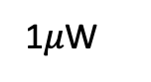
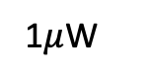
NorCal power levels
log(P)
Power
log(P)
1W
Driver
1W
Audio out
1mW
Buffer
1mW
Space
2000km
Detector
1$μ$W
1$μ$W
VFO
Mixer
1nW
AGC
1nW
Antenna
Crystal
1pW
1pW
RF filter

Slide 3
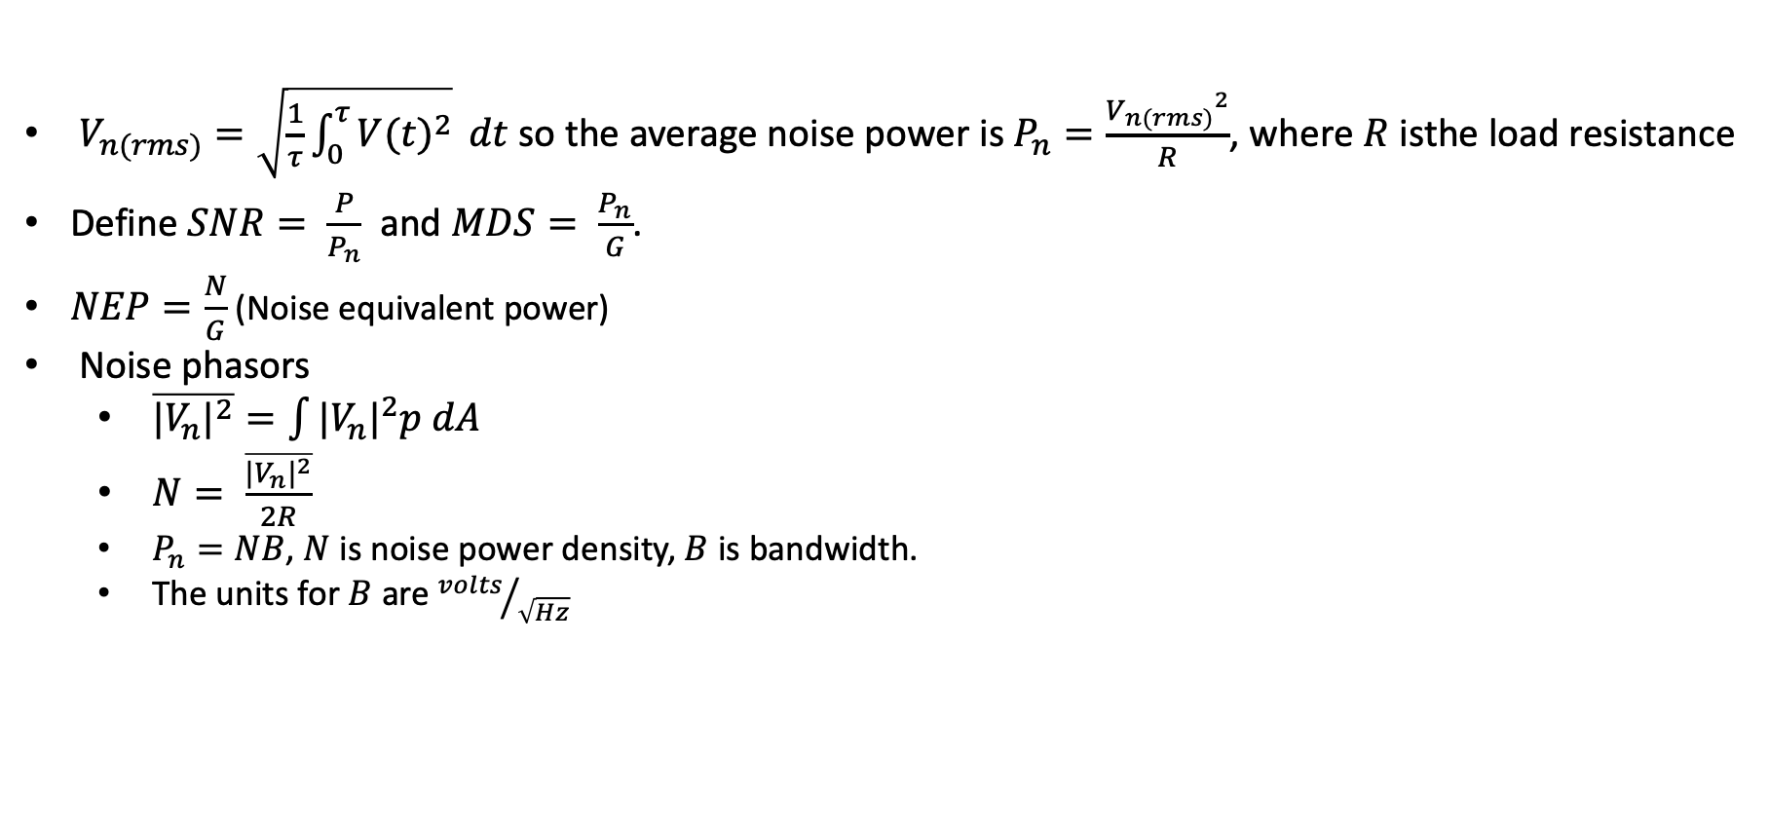
Noise
$V_{n(rms)}=\sqrt{\frac{1}{τ}\int_{0}^{τ}{{V(t)}^{2}}} dt$ so the average noise power is $P_{n}=\frac{{V_{n(rms)}}^{2}}{R}$, where $R$ isthe load resistance
Define $SNR= \frac{P}{P_{n}}$and $MDS= \frac{P_{n}}{G}$.
$NEP=\frac{N}{G}$ (Noise equivalent power)
Noise phasors
$\overline{{|V_{n}|}^{2}}=\int{|{V_{n}|}^{2}p dA}$
$N= \frac{\overline{{|V_{n}|}^{2}}}{2R}$
$P_{n}=NB$, $N$ is noise power density, $B$ is bandwidth.
The units for $B$ are ${volts}/{\sqrt{Hz}}$

Slide 4
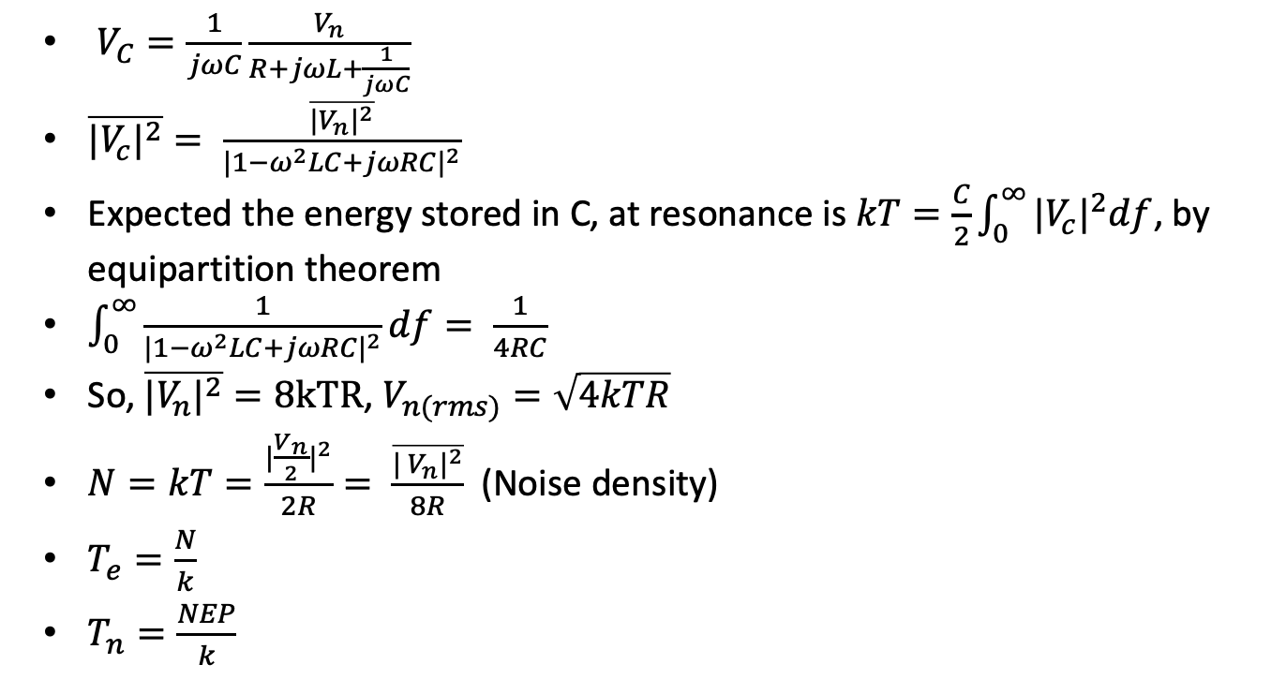
Nyquist
R
L
$V_{C}=\frac{1}{jωC}\frac{V_{n}}{R+jωL+\frac{1}{jωC}}$
$\overline{{|V_{c}|}^{2}}= \frac{\overline{{|V_{n}|}^{2}}}{{|1−ω^{2}LC+jωRC|}^{2}}$
Expected the energy stored in C, at resonance is $kT=\frac{C}{2}\int_{0}^{∞}{{|V_{c}|}^{2}df}$, by equipartition theorem
$\int_{0}^{∞}{\frac{1}{{|1−ω^{2}LC+jωRC|}^{2}}df}= \frac{1}{4RC}$
So, $\overline{{|V_{n}|}^{2}}=8kTR$, $V_{n(rms)}=\sqrt{4kTR}$
$N=kT=\frac{{|\frac{V_{n}}{2}|}^{2}}{2R}= \frac{\overline{{| V_{n}|}^{2}}}{8R}$ (Noise density)
$T_{e}=\frac{N}{k}$
$T_{n}=\frac{NEP}{k}$
V_{n}
C
V_{C}
Noise model for Nyquist
R
R
V_{n}
Matched load

Slide 5
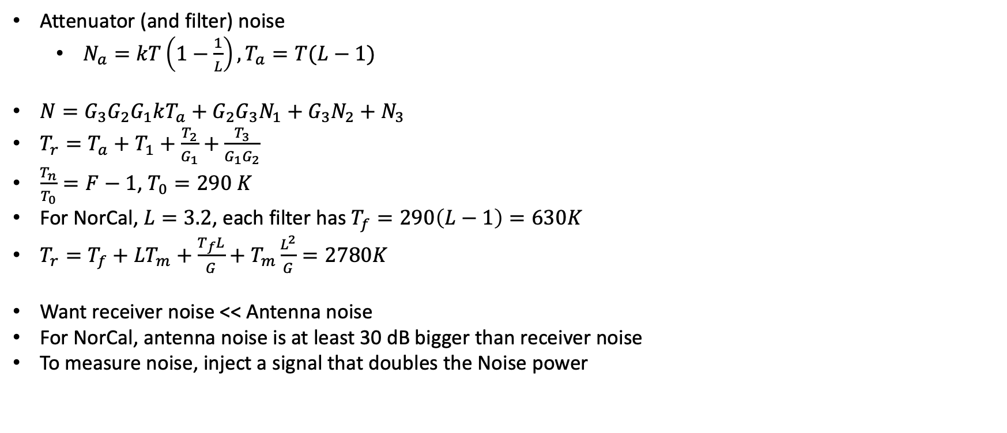
System noise
T_{a}
Attenuator (and filter) noise
$N_{a}=kT\left(1−\frac{1}{L}\right), T_{a}=T(L−1)$
$N=G_{3}G_{2}G_{1}kT_{a}+G_{2}G_{3}N_{1}+G_{3}N_{2}+N_{3}$
$T_{r}=T_{a}+T_{1}+\frac{T_{2}}{G_{1}}+\frac{T_{3}}{G_{1}G_{2}}$
$\frac{T_{n}}{T_{0}}=F−1$, $T_{0}=290 K$
For NorCal, $L=3.2$, each filter has $T_{f}=290\left(L−1\right)=630K$
$T_{r}=T_{f}+LT_{m}+\frac{T_{f}L}{G}+T_{m}\frac{L^{2}}{G}=2780K$
Want receiver noise << Antenna noise
For NorCal, antenna noise is at least 30 dB bigger than receiver noise
To measure noise, inject a signal that doubles the Noise power
N
G₁, N₁, T₁
G₂, N₂, T₂
G₃, N₃, T₃
Process Cascade

Slide 6
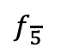
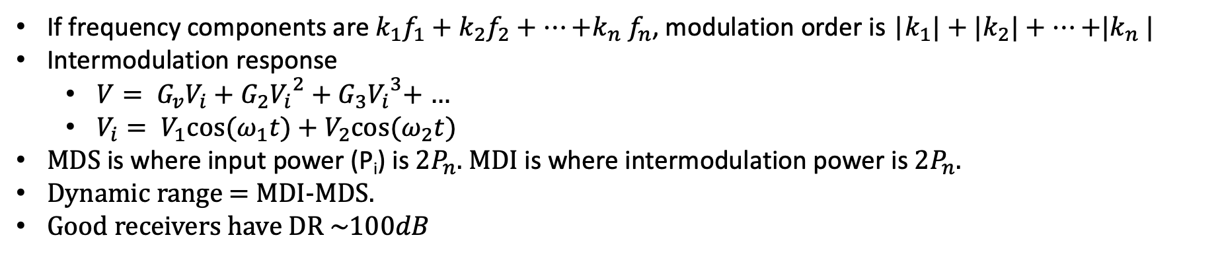
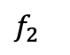
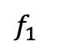
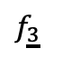
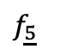
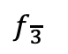
Intermodulation
If frequency components are $k_{1}f_{1}+k_{2}f_{2}+…{+k}_{n}f_{n}$, modulation order is |$k_{1}|+{|k}_{2}|+…{+|k}_{n}|$
Intermodulation response
$V= G_{v}V_{i}+G_{2}{V_{i}}^{2}+G_{3}{V_{i}}^{3}$+ …
$V_{i}= V_{1}cos⁡(ω_{1}t)+$ $V_{2}cos⁡(ω_{2}t)$
MDS is where input power (P_{i}) is $2P_{n}$. MDI is where intermodulation power is $2P_{n}$.
Dynamic range = MDI-MDS.
Good receivers have DR $\sim 100dB$
$$f_{\underline{5}}$$
$$f_{\underline{3}}$$
$$f_{1}$$
$$f_{2}$$
$$f_{\overline{3}}$$
$$f_{\overline{5}}$$
f
Intermodulation products

Slide 7
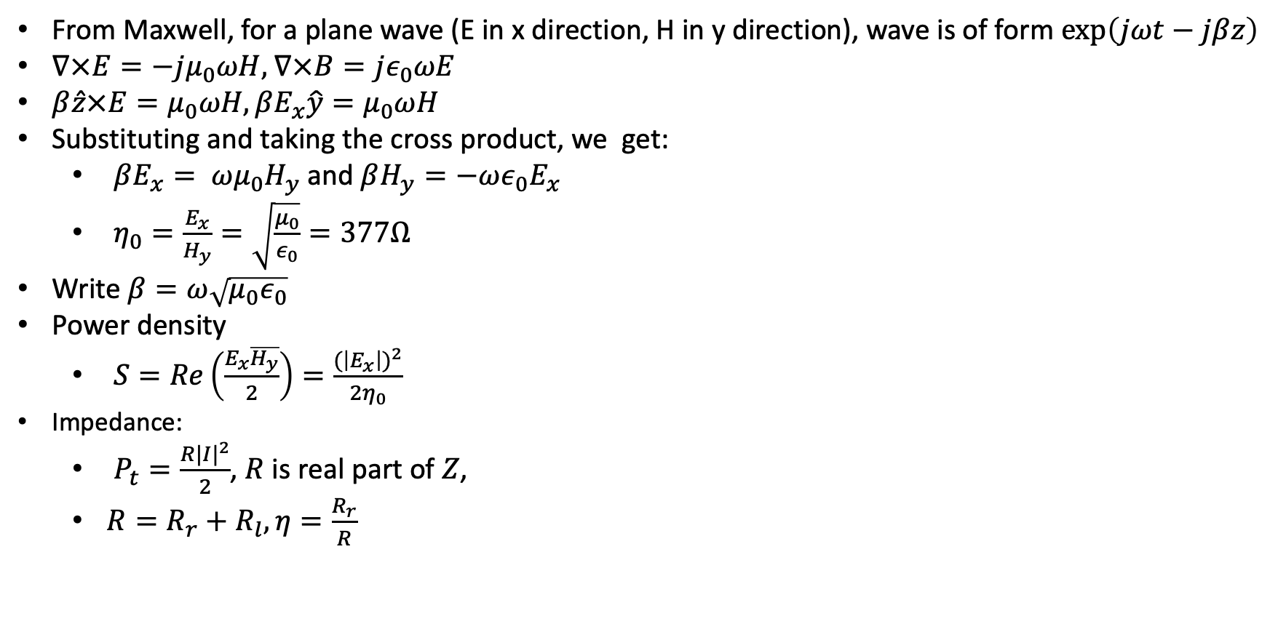
Antennas
From Maxwell, for a plane wave (E in x direction, H in y direction), wave is of form $\exp\left(jωt−jβz\right)$
$∇×E=−jμ_{0}ωH$, $∇×B=jε_{0}ωE$
$β\hat{z}×E=μ_{0}ωH, βE_{x}\hat{y}=μ_{0}ωH$
Substituting and taking the cross product, we get:
$βE_{x}= ωμ_{0}H_{y}$ and $βH_{y}=−ωε_{0}E_{x}$
$η_{0}=\frac{E_{x}}{H_{y}}=\sqrt{\frac{μ_{0}}{ε_{0}}}=377Ω$
Write $β=ω\sqrt{μ_{0}ε_{0}}$
Power density
$S=Re\left(\frac{E_{x}\overline{H_{y}}}{2}\right)=\frac{{(\left|E_{x}\right|)}^{2}}{2η_{0}}$
Impedance:
$P_{t}=\frac{R{|I|}^{2}}{2}$, $R$ is real part of $Z$,
$R=R_{r}+R_{l}, η=\frac{R_{r}}{R}$

Slide 8
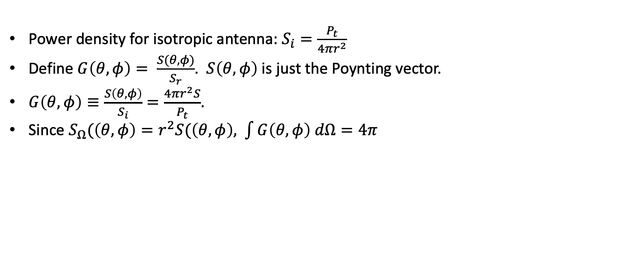
Transmitting Antennas
I
Power density for isotropic antenna: $S_{i}=\frac{P_{t}}{4πr^{2}}$
Define $G\left(θ,φ\right)= \frac{S(θ,φ)}{S_{r}}$. $S\left(θ,φ\right)$ is just the Poynting vector.
$G\left(θ,φ\right)≡\frac{S\left(θ,φ\right)}{S_{i}}=\frac{4πr^{2}S}{P_{t}}$.
Since $S_{Ω}(\left(θ,φ\right)=r^{2}S(\left(θ,φ\right)$, $\int{G\left(θ,φ\right) dΩ}=4π$
Z
Transmitting Antenna
Z
V₀
Receiving Antenna

Slide 9
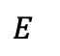
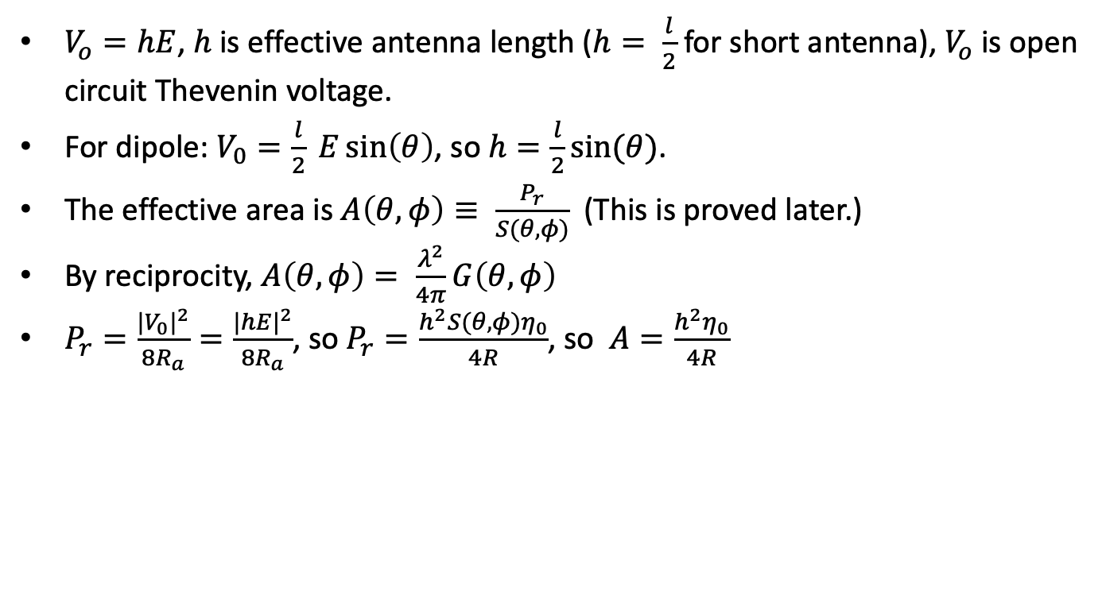
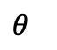
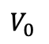
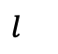
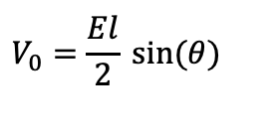
Receiving Antenna
$$E$$
$$θ$$
$$l$$
$$V_{0}$$
$V_{o}=hE$, $h$ is effective antenna length ($h= \frac{l}{2}$ for short antenna), $V_{o}$ is open circuit Thevenin voltage.
For dipole: $V_{0}=\frac{l}{2} E\sin\left(θ\right)$, so $h=\frac{l}{2}sin⁡(θ)$.
The effective area is $A\left(θ, φ\right)≡ \frac{P_{r}}{S(θ,φ)}$ (This is proved later.)
By reciprocity, $A\left(θ, φ\right)= \frac{λ^{2}}{4π}G\left(θ, φ\right)$
$P_{r}=\frac{{{|V}_{0}|}^{2}}{8R_{a}}=\frac{{|hE|}^{2}}{8R_{a}}$, so $P_{r}=\frac{h^{2}S(θ,φ)η_{0}}{4R}$, so $A=\frac{h^{2}η_{0}}{4R}$
Receiving dipole
C
R
$$V_{0}=\frac{El}{2} sin⁡(θ)$$
Dipole Thevenin equivalent circuit

Slide 10
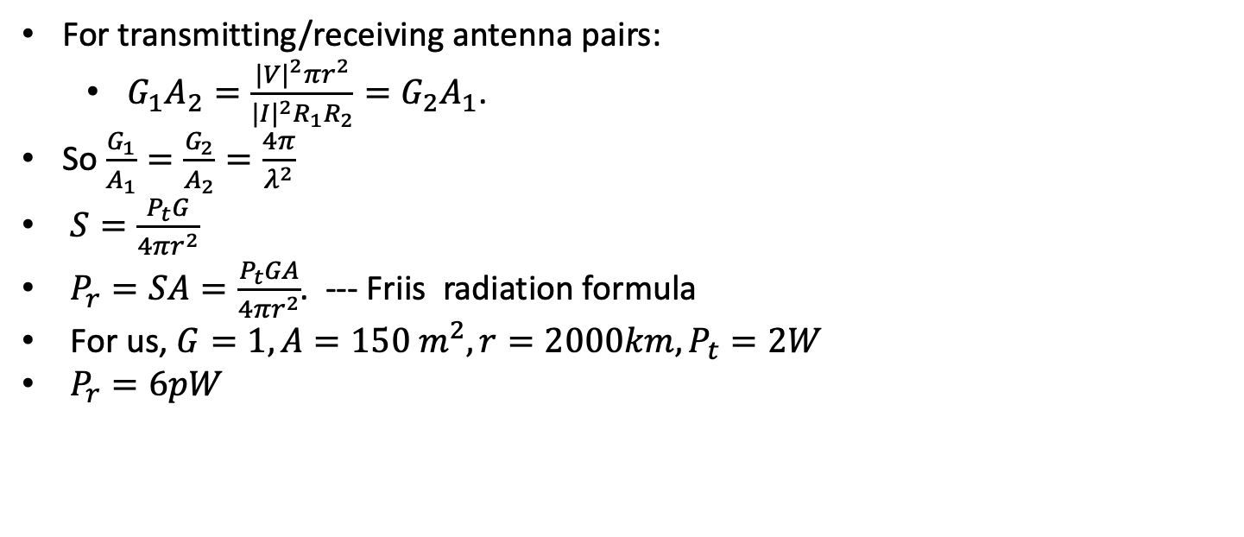
Friis formula
For transmitting/receiving antenna pairs:
$G_{1}A_{2}=\frac{{|V|}^{2}πr^{2}}{{|I|}^{2}R_{1}R_{2}}=G_{2}A_{1}$.
So $\frac{G_{1}}{A_{1}}=\frac{G_{2}}{A_{2}}=\frac{4π}{λ^{2}}$
$S=\frac{P_{t}G}{4πr^{2}}$
$P_{r}=SA=\frac{P_{t}GA}{4πr^{2}}$. --- Friis radiation formula
For us, $G=1, A=150 m^{2}, r=2000km, P_{t}=2W$
$P_{r}=6pW$
G_{r}, A_{r}, R_{r}
I
V
G_{t}, A_{t}, R_{t}

Slide 11
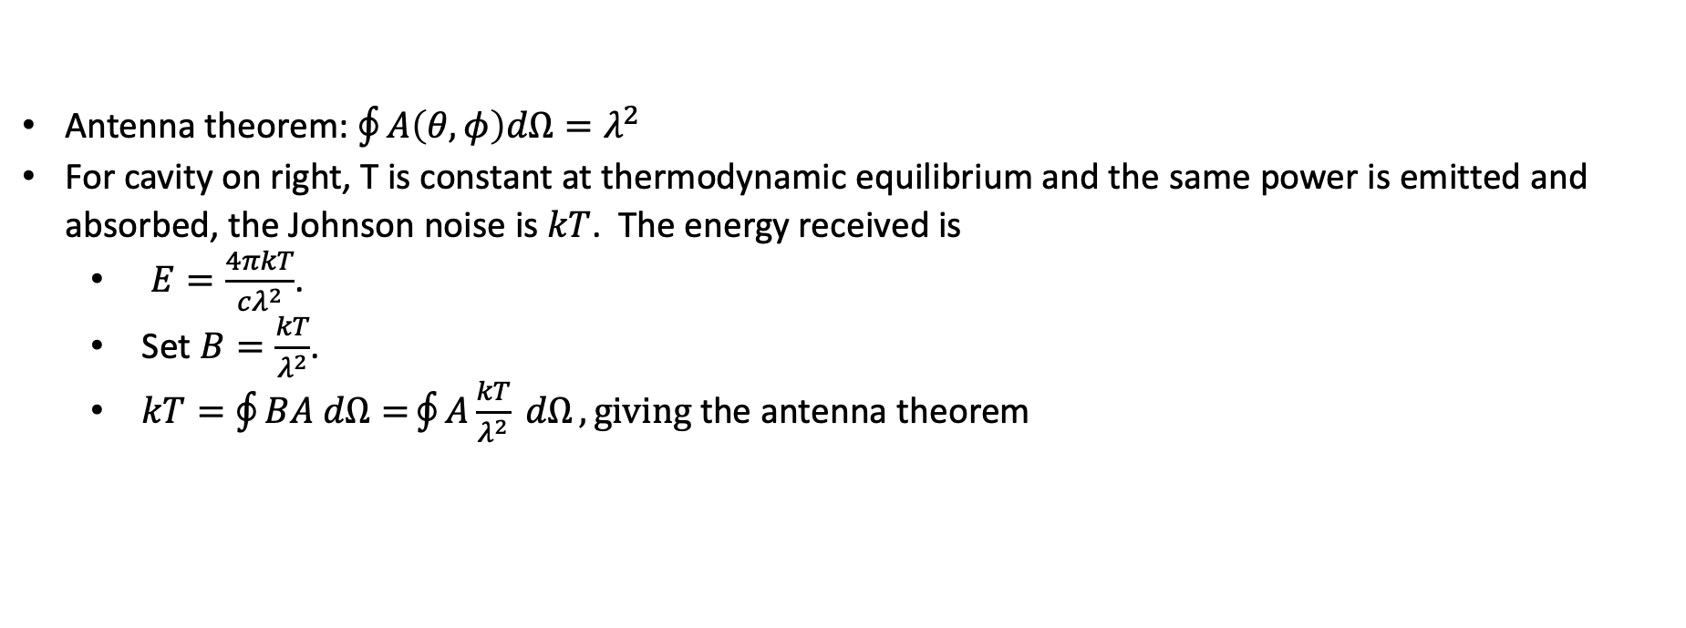
Antenna Theorem
Antenna theorem: $\oint{A\left(θ, φ\right)dΩ=λ^{2}}$
For cavity on right, T is constant at thermodynamic equilibrium and the same power is emitted and absorbed, the Johnson noise is $kT$. The energy received is
$E=\frac{4πkT}{cλ^{2}}$.
Set $B=\frac{kT}{λ^{2}}$.
$kT=\oint{BA dΩ=}\oint{A\frac{kT}{λ^{2}} dΩ}, giving$the antenna theorem
T
A
Insulated cavity

Slide 12
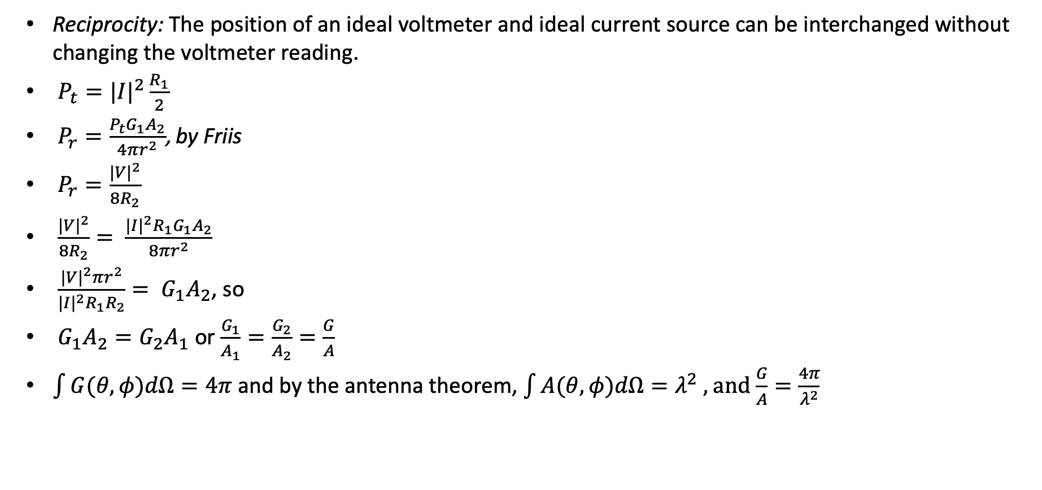
Reciprocity
Reciprocity: The position of an ideal voltmeter and ideal current source can be interchanged without changing the voltmeter reading.
$P_{t}={|I|}^{2}\frac{R_{1}}{2}$
$P_{r}=\frac{P_{t}G_{1}A_{2}}{4πr^{2}}$, by Friis
$P_{r}=\frac{{|V|}^{2}}{8R_{2}}$
$\frac{{|V|}^{2}}{8R_{2}}= \frac{{|I|}^{2}R_{1}G_{1}A_{2}}{8πr^{2}}$
$\frac{{|V|}^{2}πr^{2}}{{|I|}^{2}R_{1}R_{2}}= G_{1}A_{2}$, so
$G_{1}A_{2}=G_{2}A_{1}$ or $\frac{G_{1}}{A_{1}}=\frac{G_{2}}{A_{2}}=\frac{G}{A}$
$\int{G(θ,φ)dΩ}=4π$ and by the antenna theorem, $\int{A(θ,φ)dΩ}=λ^{2}$ , and $\frac{G}{A}=\frac{4π}{λ^{2}}$
G₂, A₂, R₂
I
V
G₁, A₁, R₁

Slide 13
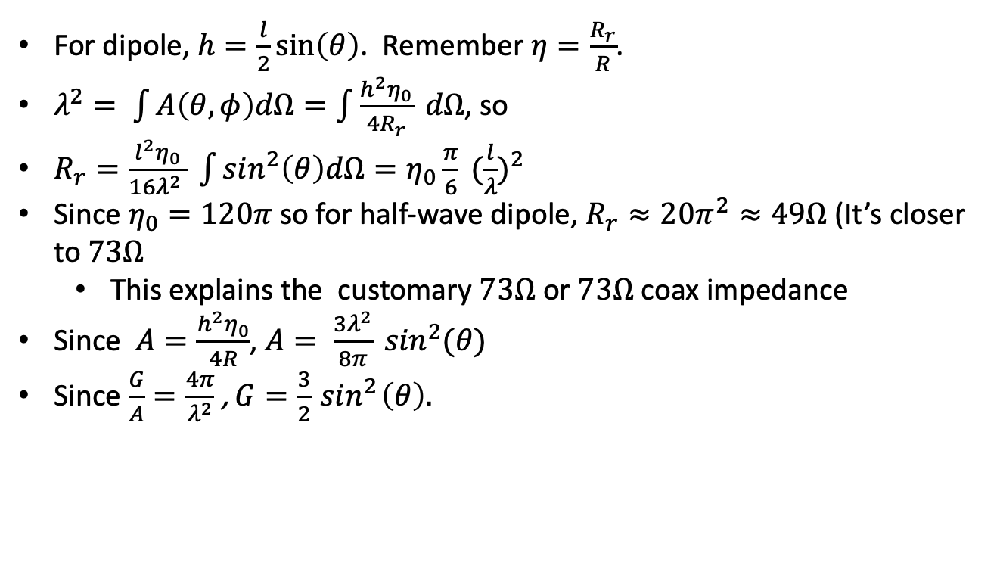
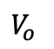
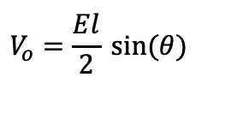
Reciprocity and dipoles
$$E$$
$$θ$$
$$l$$
$$V_{o}$$
For dipole, $h=\frac{l}{2}\sin\left(θ\right)$. Remember $η=\frac{R_{r}}{R}$.
$λ^{2}= \int{A\left(θ, φ\right)dΩ=\int{\frac{h^{2}η_{0}}{4R_{r}} dΩ}}$, so
$R_{r}=\frac{l^{2}η_{0}}{16λ^{2} } \int{\sin^{2}\left(θ\right)dΩ=η_{0}\frac{π}{6}} {(\frac{l}{λ})}^{2}$
Since $η_{0}=120π$ so for half-wave dipole, $R_{r}≈20π^{2}≈49Ω$ (It’s closer to $73Ω$
This explains the customary $73Ω$ or $73Ω$ coax impedance
Since $A=\frac{h^{2}η_{0}}{4R}$, $A= \frac{3λ^{2}}{8π} \sin^{2}(θ)$
Since $\frac{G}{A}=\frac{4π}{λ^{2}}$, $G=\frac{3}{2}\sin^{2}\left(θ\right).$
Receiving dipole
C
R
$$V_{o}=\frac{El}{2} sin⁡(θ)$$
Dipole Thevenin equivalent circuit

Slide 14
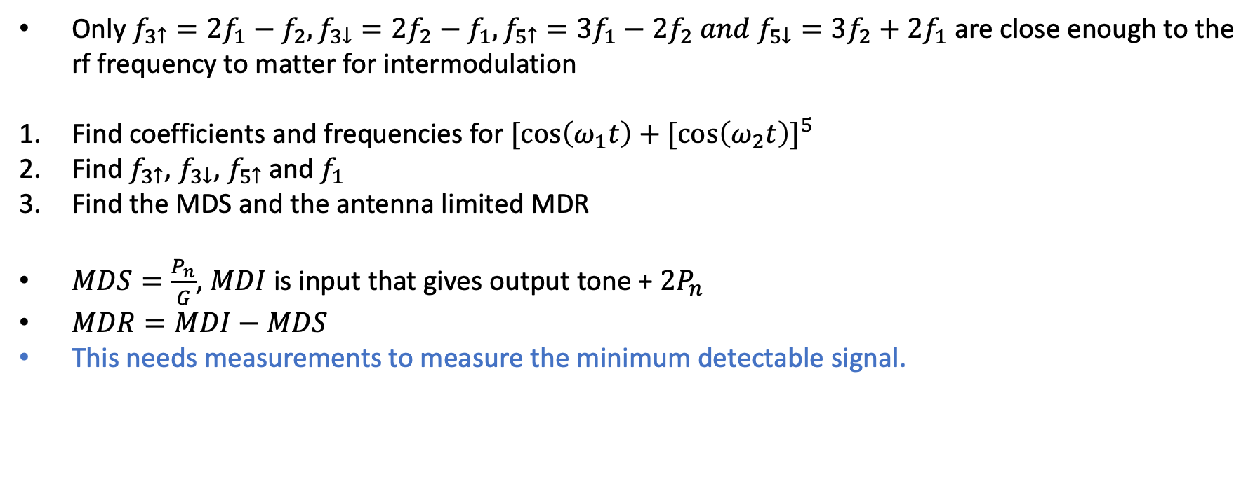
Exercise 35: Intermodulation
Only $f_{3↑}=2f_{1}−f_{2}, f_{3↓}=2f_{2}−f_{1},f_{5↑}=3f_{1}−2f_{2} and f_{5↓}=3f_{2}+2f_{1}$ are close enough to the rf frequency to matter for intermodulation
Find coefficients and frequencies for ${[\cos\left(ω_{1}t\right)+[\cos\left(ω_{2}t\right)]}^{5}$
Find $f_{3↑}$, $f_{3↓}$, $f_{5↑}$ and $f_{1}$
Find the MDS and the antenna limited MDR
$MDS=\frac{P_{n}}{G}$, $MDI$ is input that gives output tone + $2P_{n}$
$MDR=MDI−MDS$
This needs measurements to measure the minimum detectable signal.

Slide 15
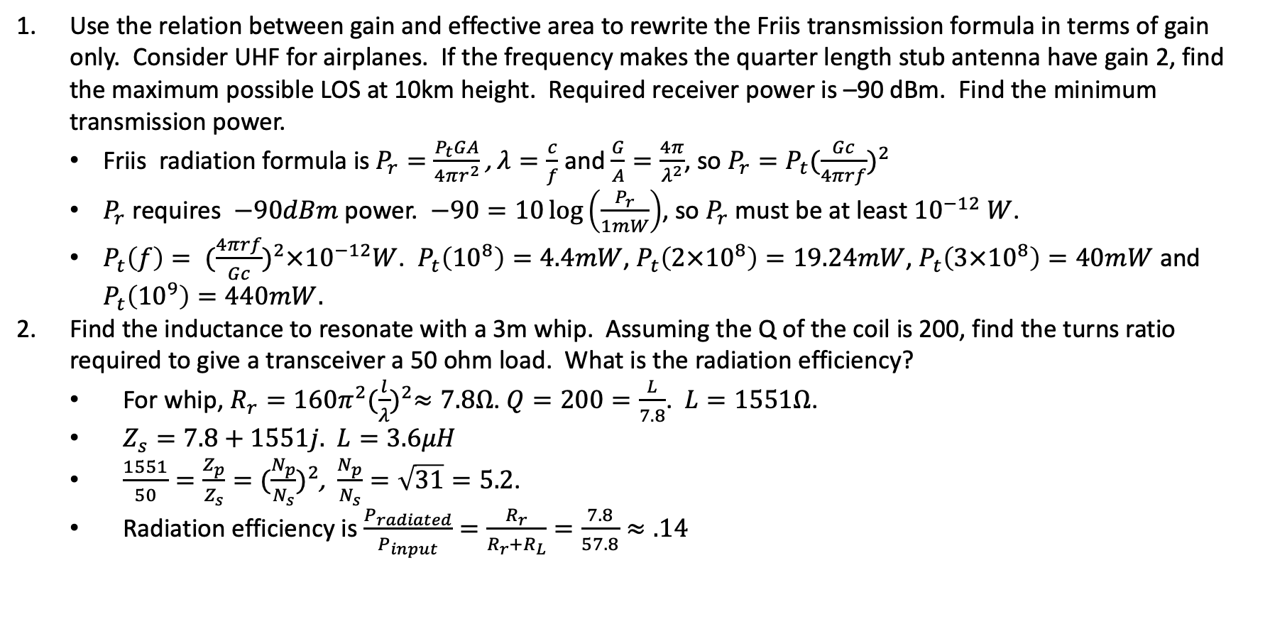
Exercise 37: Antennas
Use the relation between gain and effective area to rewrite the Friis transmission formula in terms of gain only. Consider UHF for airplanes. If the frequency makes the quarter length stub antenna have gain 2, find the maximum possible LOS at 10km height. Required receiver power is –90 dBm. Find the minimum transmission power.
Friis radiation formula is $P_{r}=\frac{P_{t}GA}{4πr^{2}}$, $λ=\frac{c}{f}$ and $\frac{G}{A}=\frac{4π}{λ^{2}}$, so $P_{r}=P_{t}{(\frac{Gc}{4πrf})}^{2}$
$P_{r}$ requires $−90dBm$ power. $−90=10\log\left(\frac{P_{r}}{1mW}\right)$, so $P_{r}$ must be at least ${10}^{−12} W$.
$P_{t}\left(f\right)= {(\frac{4πrf}{Gc})}^{2}×{10}^{−12}W$. $P_{t}\left({10}^{8}\right)=4.4mW$, $P_{t}\left({2×10}^{8}\right)=19.24mW$, $P_{t}\left(3×{10}^{8}\right)=40mW$ and $P_{t}\left({10}^{9}\right)=440mW.$
Find the inductance to resonate with a 3m whip. Assuming the Q of the coil is 200, find the turns ratio required to give a transceiver a 50 ohm load. What is the radiation efficiency?
For whip, $R_{r}=160π^{2}{(\frac{l}{λ})}^{2}≈7.8Ω$. $Q=200=\frac{L}{7.8}$. $L=1551Ω$.
$Z_{s}=7.8+1551j.$ $L=3.6μH$
$\frac{1551}{50}=\frac{Z_{p}}{Z_{s}}={(\frac{N_{p}}{N_{s}})}^{2}$, $\frac{N_{p}}{N_{s}}=\sqrt{31}=5.2$.
Radiation efficiency is $\frac{P_{radiated}}{P_{input}}=\frac{R_{r}}{R_{r}+R_{L}}=\frac{7.8}{57.8}≈.14$

Slide 16
Norcal circuit diagram, 1

Slide 17
Norcal circuit diagram, 2

Slide 18
Norcal circuit diagram, 3

Slide 19
Norcal circuit diagram, 4

Slide 20
Norcal circuit diagram, 5

Slide 21
Exercise 17: Tuned Speaker
Connect speaker to function generator 600Hz, 25mVrms.
Sound peaks at resonance. Find resonant frequency L_{p}.
Measure f_{l}, f_{u} by noting the 3dB loss. Calculate Q.
Use voltmeter to find resonance with speaker (nominally 8ohm) to calculate impedance
Calculate the resonant frequency from a transmission line equivalent circuit.

Slide 22
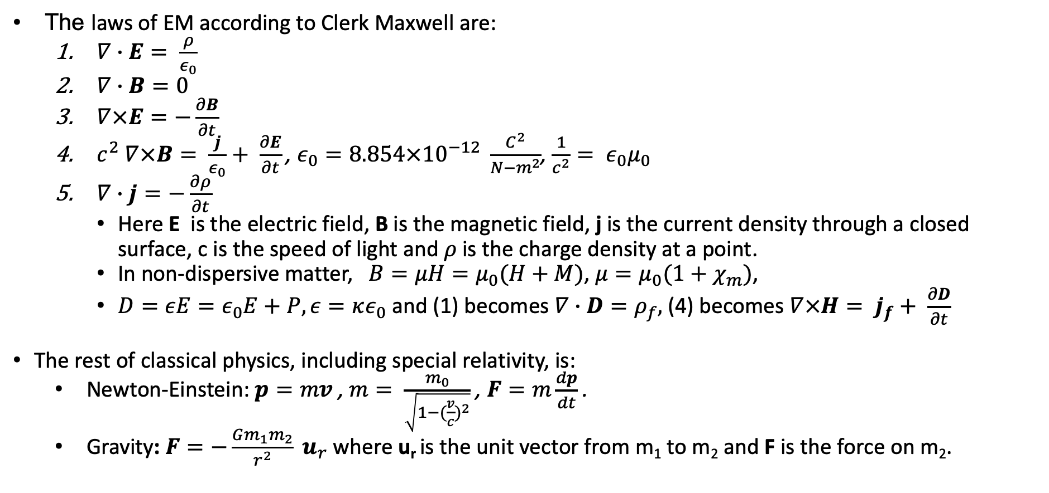
In the beginning…
The laws of EM according to Clerk Maxwell are:
$∇∙E= \frac{ρ}{ε_{0}}$
$∇∙B=0$
$∇×E=−\frac{∂B}{∂t}$
$c^{2} ∇×B= \frac{j}{ε_{0}}+ \frac{∂E}{∂t}$, $ε_{0}=8.854×{10}^{−12} \frac{C^{2}}{N−m^{2}}$, $\frac{1}{c^{2}}= ε_{0}μ_{0}$
$∇∙j=−\frac{∂ρ}{∂t}$
Here E is the electric field, B is the magnetic field, j is the current density through a closed surface, c is the speed of light and 𝜌 is the charge density at a point.
In non-dispersive matter, $B=μH=μ_{0}(H+M)$, $μ=μ_{0}(1+χ_{m})$,
$D=εE=ε_{0}E+P, ε=κε_{0}$ and (1) becomes $∇∙D=ρ_{f},$(4) becomes $∇×H= j_{f}+ \frac{∂D}{∂t}$
The rest of classical physics, including special relativity, is:
Newton-Einstein: $p=mv$, $m= \frac{m_{0}}{\sqrt{1−{(\frac{v}{c})}^{2}}}$ , $F=m\frac{dp}{dt}$ .
Gravity: $F=−\frac{Gm_{1}m_{2}}{r^{2}} u_{r}$ where u_{r} is the unit vector from m₁ to m₂ and F is the force on m₂.

Slide 23
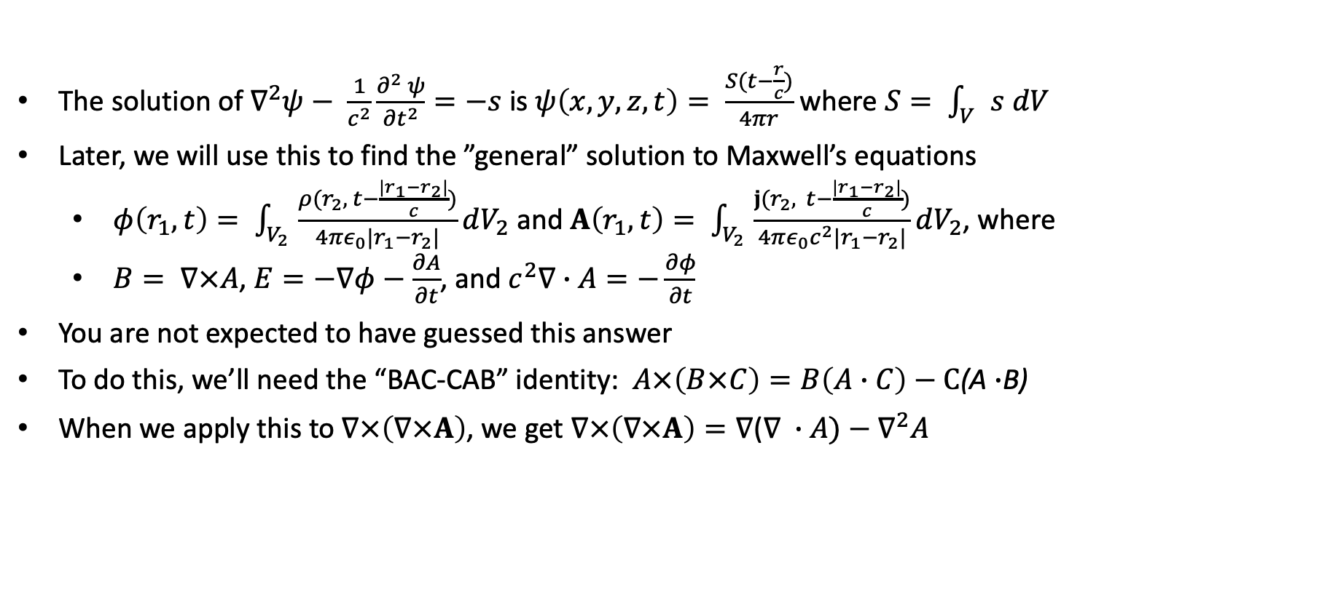
Solutions to the wave equation
The solution of $∇^{2}ψ− \frac{1}{c^{2}}\frac{∂^{2} ψ}{{∂t}^{2}}=−s$ is $ψ\left(x,y,z,t\right)= \frac{S(t−\frac{r}{c})}{4πr}$ where $S= \int_{V}{s dV}$
Later, we will use this to find the ”general” solution to Maxwell’s equations
$φ\left(r_{1}, t\right)= \int_{V_{2}}{\frac{ρ(r_{2}, t−\frac{|r_{1}−r_{2}|}{c})}{4πε_{0}|r_{1}−r_{2}|}dV_{2}}$ and $A\left(r_{1}, t\right)= \int_{V_{2}}{\frac{j(r_{2}, t−\frac{|r_{1}−r_{2}|}{c})}{4πε_{0}c^{2}|r_{1}−r_{2}|}dV_{2}}$, where
$B= ∇×A$, $E=−∇φ−\frac{∂A}{∂t}$, and $c^{2}∇∙A=−\frac{∂φ}{∂t}$
You are not expected to have guessed this answer
To do this, we’ll need the “BAC-CAB” identity: $A×\left(B×C\right)=B\left(A∙C\right)−C$(A $∙$B)
When we apply this to $∇×\left(∇×A\right)$, we get $∇×\left(∇×A\right)=∇$($∇ ∙A)−∇^{2}A$

Slide 24
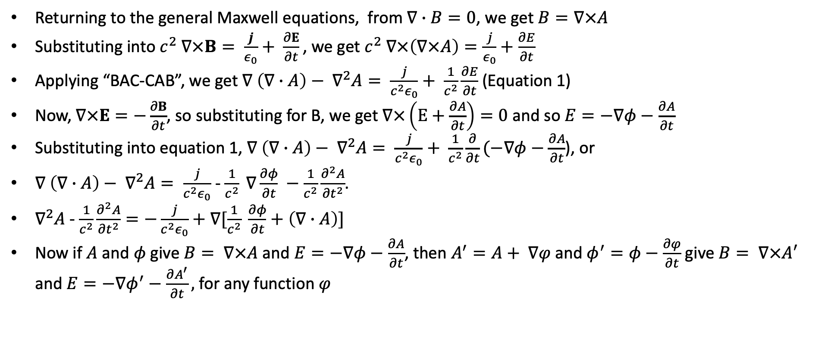
General solution to Maxwell’s equations
Returning to the general Maxwell equations, from $∇∙B=0$, we get $B=∇×A$
Substituting into $c^{2} ∇×B= \frac{j}{ε_{0}}+ \frac{∂E}{∂t}$, we get $c^{2} ∇×\left(∇×A\right)=\frac{j}{ε_{0}}+\frac{∂E}{∂t}$
Applying “BAC-CAB”, we get $∇ \left(∇∙A\right)− ∇^{2}A= \frac{j}{c^{2}ε_{0}}+ \frac{1}{c^{2}}\frac{∂E}{∂t}$ (Equation 1)
Now, $∇×E=−\frac{∂B}{∂t}$, so substituting for B, we get $∇×\left(E+\frac{∂A}{∂t}\right)=0$ and so $E=−∇φ−\frac{∂A}{∂t}$
Substituting into equation 1, $∇ \left(∇∙A\right)− ∇^{2}A= \frac{j}{c^{2}ε_{0}}+ \frac{1}{c^{2}}\frac{∂}{∂t}(−∇φ−\frac{∂A}{∂t}$), or
$∇ \left(∇∙A\right)− ∇^{2}A= \frac{j}{c^{2}ε_{0}}$ - $\frac{1}{c^{2}} ∇\frac{∂φ}{∂t} −\frac{1}{c^{2}}\frac{∂^{2}A}{{∂t}^{2}}$.
$∇^{2}A$ - $\frac{1}{c^{2}}\frac{∂^{2}A}{{∂t}^{2}}=−\frac{j}{c^{2}ε_{0}}+∇[\frac{1}{c^{2}} \frac{∂φ}{∂t}+\left(∇∙A\right)]$
Now if $A$ and $φ$ give $B= ∇×A$ and $E=−∇φ−\frac{∂A}{∂t}$, then $A^{′}=A+ ∇φ$ and $φ^{′}=φ−\frac{∂φ}{∂t}$ give $B= ∇×A′$ and $E=−∇φ^{′}−\frac{∂A^{′}}{∂t},$ for any function $φ$

Slide 25
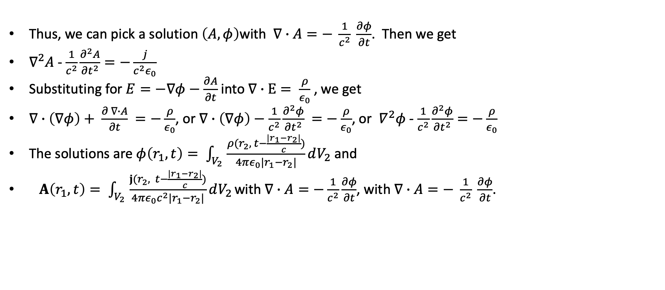
General solution to Maxwell’s equations
Thus, we can pick a solution $\left(A, φ\right)$with $∇∙A=− \frac{1}{c^{2}} \frac{∂φ}{∂t}$. Then we get
$∇^{2}A$ - $\frac{1}{c^{2}}\frac{∂^{2}A}{{∂t}^{2}}=−\frac{j}{c^{2}ε_{0}}$
Substituting for $E=−∇φ−\frac{∂A}{∂t}$ into $∇∙E= \frac{ρ}{ε_{0}}$, we get
$∇∙\left(∇φ\right)+ \frac{∂ ∇∙A}{∂t} =−\frac{ρ}{ε_{0}}$, or $∇∙\left(∇φ\right)−\frac{1}{c^{2}}\frac{∂^{2}φ}{{∂t}^{2}} =−\frac{ρ}{ε_{0}}$, or $∇^{2}φ$ - $\frac{1}{c^{2}}\frac{∂^{2}φ}{{∂t}^{2}}=−\frac{ρ}{ε_{0}}$
The solutions are $φ\left(r_{1}, t\right)= \int_{V_{2}}{\frac{ρ(r_{2}, t−\frac{|r_{1}−r_{2}|}{c})}{4πε_{0}|r_{1}−r_{2}|}dV_{2}}$ and
$A\left(r_{1}, t\right)= \int_{V_{2}}{\frac{j(r_{2}, t−\frac{|r_{1}−r_{2}|}{c})}{4πε_{0}c^{2}|r_{1}−r_{2}|}dV_{2}}$ with $∇∙A=−\frac{1}{c^{2}}\frac{∂φ}{∂t}$, with $∇∙A=− \frac{1}{c^{2}} \frac{∂φ}{∂t}$.

Slide 26
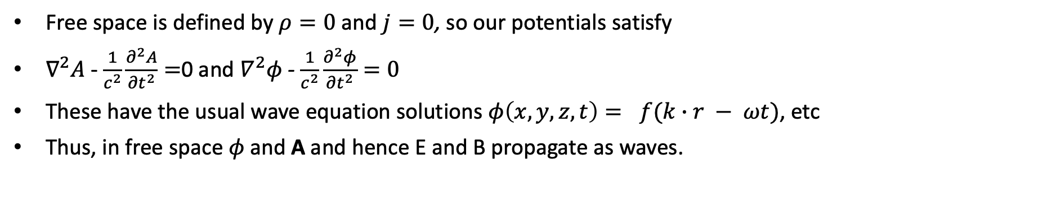
Solution to Maxwell’s equations in free space
Free space is defined by $ρ=0$ and $j=0$, so our potentials satisfy
$∇^{2}A$ - $\frac{1}{c^{2}}\frac{∂^{2}A}{{∂t}^{2}}=$0 and $∇^{2}φ$ - $\frac{1}{c^{2}}\frac{∂^{2}φ}{{∂t}^{2}}=0$
These have the usual wave equation solutions $φ\left(x,y,z,t\right)= f(k∙r − ωt)$, etc
Thus, in free space 𝜙 and A and hence E and B propagate as waves.

Slide 27
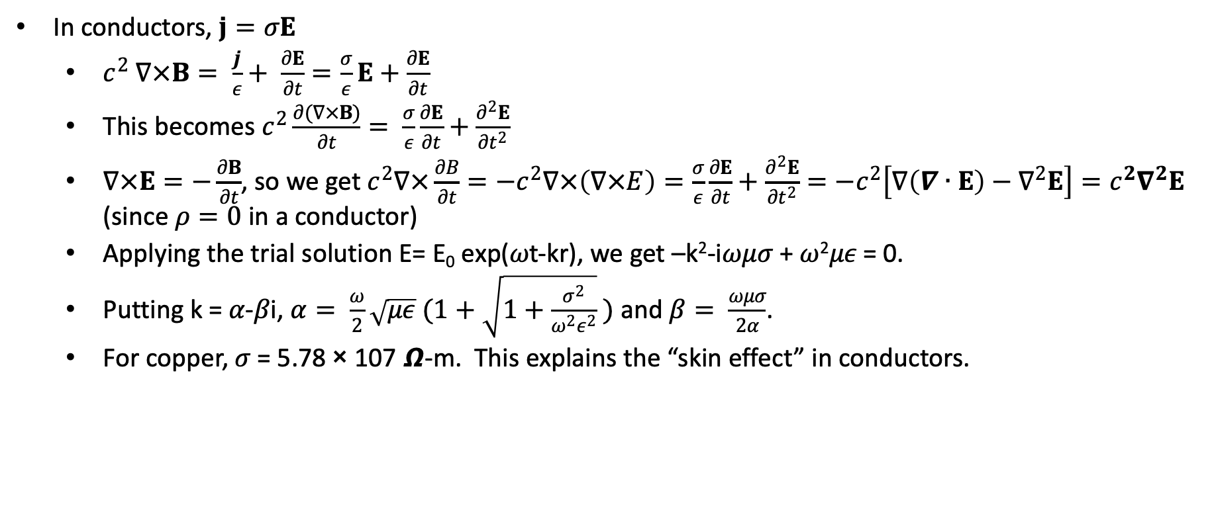
Solution to Maxwell’s equations in conductors
In conductors, $j=σE$
$c^{2} ∇×B= \frac{j}{ε}+ \frac{∂E}{∂t}=\frac{σ}{ε}E+\frac{∂E}{∂t}$
This becomes $c^{2}\frac{∂(∇×B)}{∂t}= \frac{σ}{ε}\frac{∂E}{∂t}+\frac{∂^{2}E}{{∂t}^{2}}$
$∇×E=−\frac{∂B}{∂t}$, so we get $c^{2}∇×\frac{∂B}{∂t}=−c^{2}∇×\left(∇×E\right)=\frac{σ}{ε}\frac{∂E}{∂t}+\frac{∂^{2}E}{{∂t}^{2}}=−c^{2}\left[∇\left(∇∙E\right)−∇^{2}E\right]=c^{2}∇^{2}E$ (since $ρ=0$ in a conductor)
Applying the trial solution E= E₀ exp(𝜔t-kr), we get –k²-i𝜔𝜇𝜎 + 𝜔²𝜇𝜖 = 0.
Putting k = 𝛼-𝛽i, $α= \frac{ω}{2}\sqrt{με} (1+\sqrt{1+\frac{σ^{2}}{ω^{2}ε^{2}}} )$ and $β= \frac{ωμσ}{2α}$.
For copper, 𝜎 = 5.78 × 107 𝞨-m. This explains the “skin effect” in conductors.

Slide 28
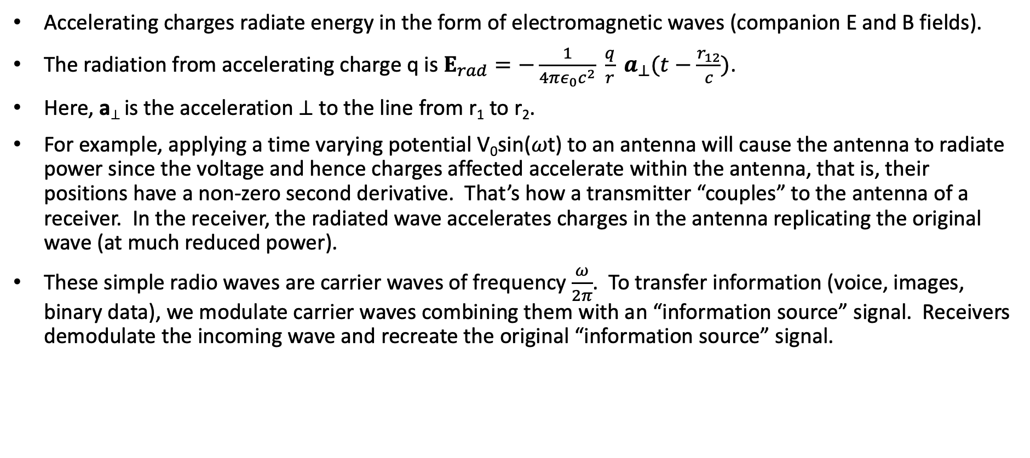
Radiation, antennas
Accelerating charges radiate energy in the form of electromagnetic waves (companion E and B fields).
The radiation from accelerating charge q is $E_{rad}=−\frac{1}{4πε_{0}c^{2}} \frac{q}{r} a_{⊥}(t−\frac{r_{12}}{c})$.
Here, a⊥ is the acceleration ⊥ to the line from r₁ to r₂.
For example, applying a time varying potential V₀sin(𝜔t) to an antenna will cause the antenna to radiate power since the voltage and hence charges affected accelerate within the antenna, that is, their positions have a non-zero second derivative. That’s how a transmitter “couples” to the antenna of a receiver. In the receiver, the radiated wave accelerates charges in the antenna replicating the original wave (at much reduced power).
These simple radio waves are carrier waves of frequency $\frac{ω}{2π}$. To transfer information (voice, images, binary data), we modulate carrier waves combining them with an “information source” signal. Receivers demodulate the incoming wave and recreate the original “information source” signal.

Slide 29
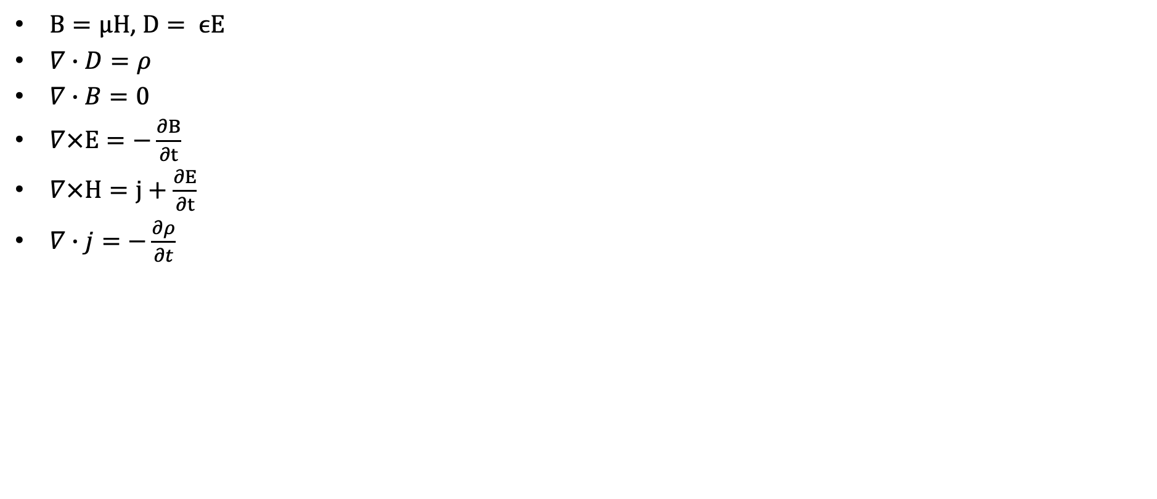
Maxwell’s equations in a non-dispersive media
$B=μH$, $D= ϵE$
$∇∙D=ρ$
$∇∙B=0$
$∇×E=−\frac{∂B}{∂t}$
$∇×H=j+\frac{∂E}{∂t}$
$∇∙j=−\frac{∂ρ}{∂t}$

Slide 30
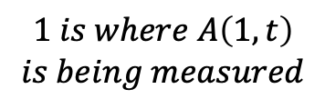
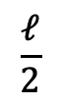

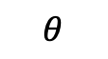
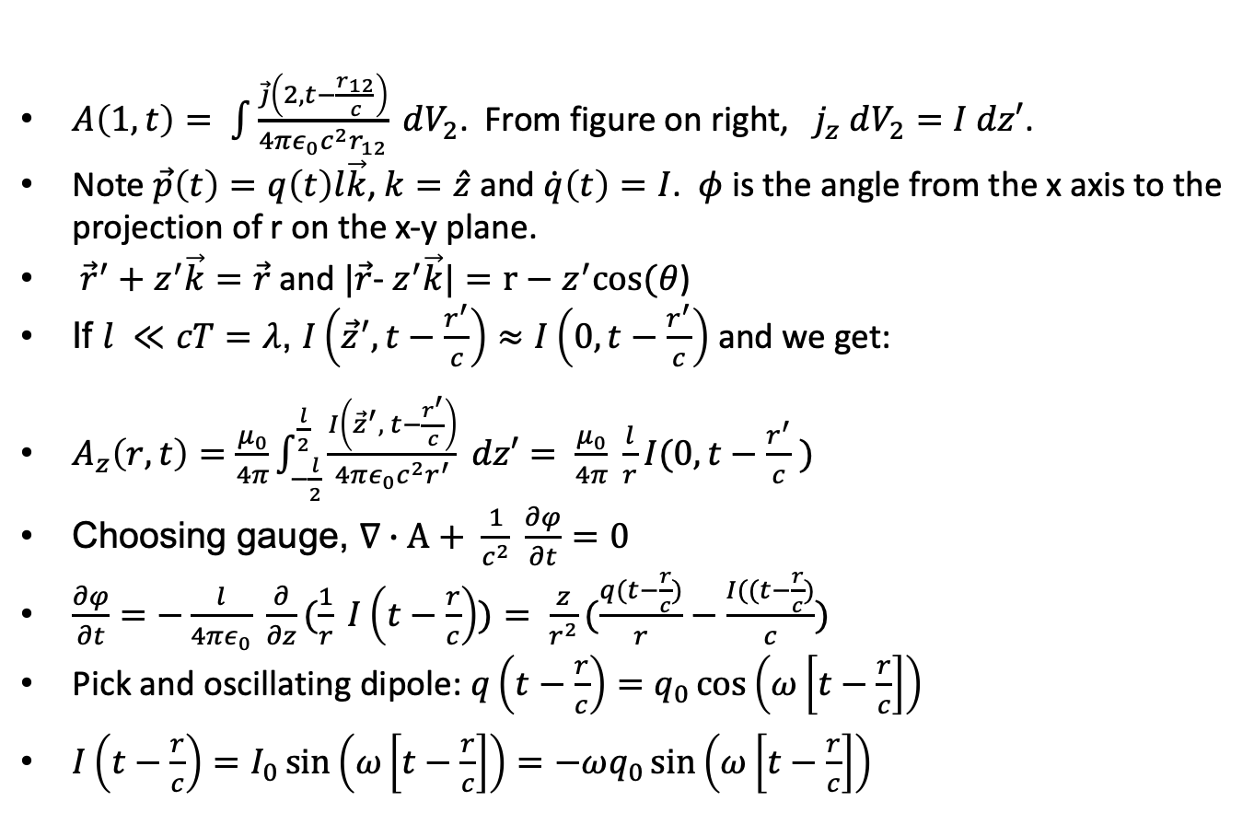
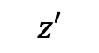
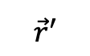
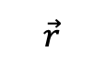
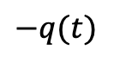
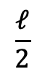
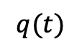
Radiation from a small dipole
$A\left(1,t\right)= \int{\frac{\vec{j}\left(2, t−\frac{r_{12}}{c}\right)}{4πε_{0}c^{2}r_{12}}} dV_{2}$. From figure on right, $j_{z} dV_{2}=I dz′$.
Note $\vec{p}\left(t\right)=q\left(t\right)l\vec{k}$, $k=\hat{z}$ and $\dot{q}\left(t\right)=I$. $φ$ is the angle from the x axis to the projection of r on the x-y plane.
${\vec{r}}^{′}+z^{′}\vec{k}=\vec{r}$ and $|\vec{r}$- $z^{′}\vec{k}|=r−z^{′}cos⁡(θ$)
If $l ≪cT=λ$, $I\left({\vec{z}}^{′}, t−\frac{r^{′}}{c}\right)≈I\left(0, t−\frac{r^{′}}{c}\right)$ and we get:
$A_{z}\left(r,t\right)=\frac{μ_{0}}{4π}\int_{−\frac{l}{2}}^{\frac{l}{2}}{\frac{I\left({\vec{z}}^{′}, t−\frac{r^{′}}{c}\right)}{4πε_{0}c^{2}r^{′}} dz′}= \frac{μ_{0}}{4π} \frac{l}{r}I(0, t−\frac{r^{′}}{c} )$
Choosing gauge, $∇∙A+ \frac{1}{c^{2}} \frac{∂φ}{∂t}=0$
$\frac{∂φ}{∂t}=−\frac{l}{4πε_{0}} \frac{∂}{∂z}(\frac{1}{r} I\left(t−\frac{r}{c}\right))= \frac{z}{r^{2}}(\frac{q(t−\frac{r}{c})}{r}−\frac{I((t−\frac{r}{c})}{c})$
Pick and oscillating dipole: $q\left(t−\frac{r}{c}\right)=q_{0}\cos\left(ω\left[t−\frac{r}{c}\right]\right)$
$I\left(t−\frac{r}{c}\right)=I_{0}\sin\left(ω\left[t−\frac{r}{c}\right]\right)=−ωq_{0}\sin\left(ω\left[t−\frac{r}{c}\right]\right)$
$$q(t)$$
$$1 is where A\left(1,t\right)$$
$$is being measured$$
$$\vec{r}′$$
$$1$$
$$\frac{ℓ}{2}$$
$$z′$$
$$\vec{r}$$
$$θ$$
y
$$\frac{ℓ}{2}$$
z
$$−q(t)$$

Slide 31
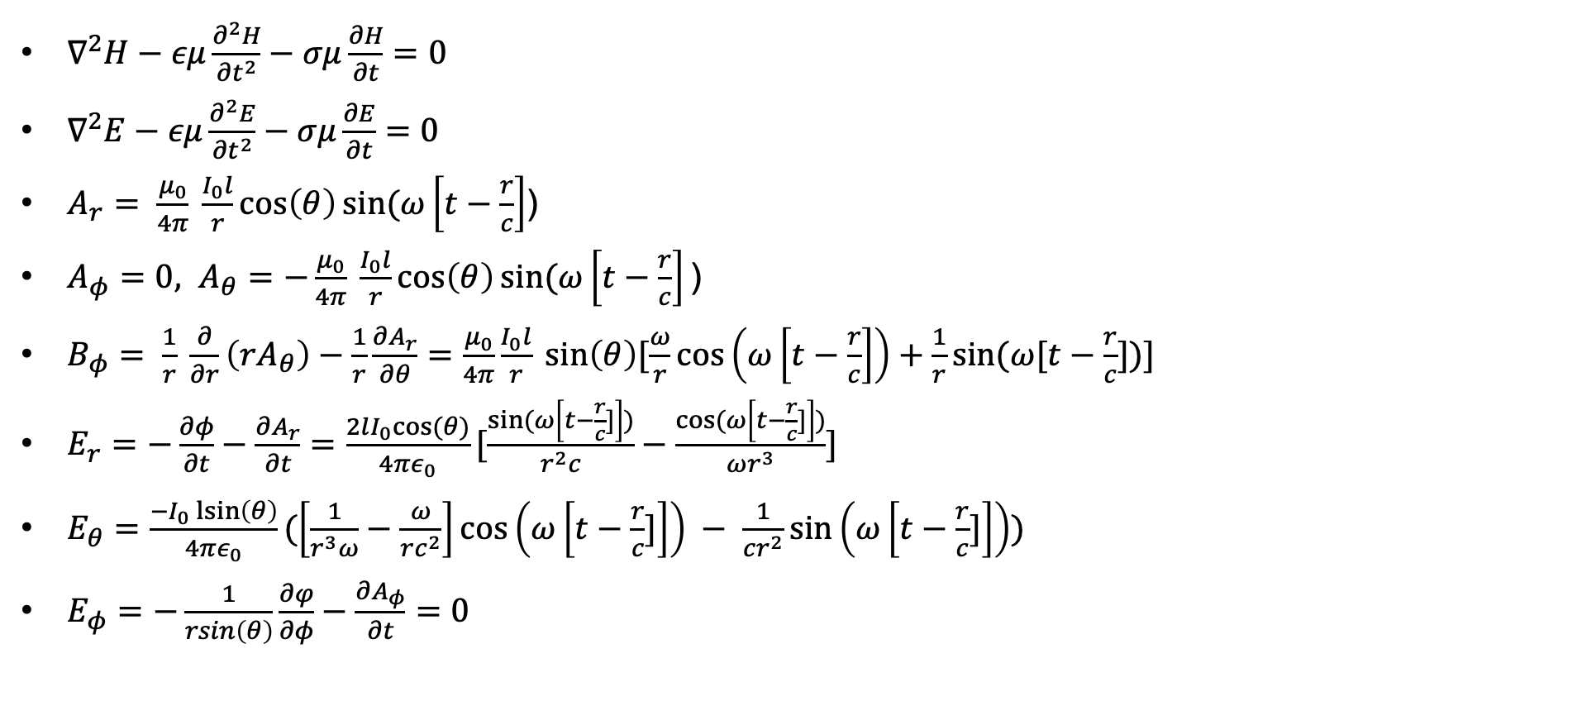
Radiation from a small dipole
$∇^{2}H−εμ\frac{∂^{2}H}{{∂t}^{2}}−σμ\frac{∂H}{∂t}=0$
$∇^{2}E−εμ\frac{∂^{2}E}{{∂t}^{2}}−σμ\frac{∂E}{∂t}=0$
$A_{r}= \frac{μ_{0}}{4π} \frac{I_{0}l}{r}\cos\left(θ\right)sin⁡(ω\left[t−\frac{r}{c}\right]$)
$A_{φ}=0, A_{θ}=−\frac{μ_{0}}{4π} \frac{I_{0}l}{r}\cos\left(θ\right)sin⁡(ω\left[t−\frac{r}{c}\right]\text{)}$
$B_{φ}= \frac{1}{r} \frac{∂}{∂r}\left(rA_{θ}\right)−\frac{1}{r}\frac{∂A_{r}}{∂θ}=\frac{μ_{0}}{4π}\frac{I_{0}l}{r} sin\left(θ\right)[\frac{ω}{r}\cos\left(ω\left[t−\frac{r}{c}\right]\right)+\frac{1}{r}sin⁡(ω[t−\frac{r}{c}])]$
$E_{r}=−\frac{∂φ}{∂t}−\frac{∂A_{r}}{∂t}=\frac{2lI_{0}cos⁡(θ)}{4πε_{0}}[\frac{sin⁡(ω\left[t−\frac{r}{c}]\right])}{r^{2}c}−\frac{cos⁡(ω\left[t−\frac{r}{c}]\right])}{ωr^{3}}]$
$E_{θ}=\frac{−I_{0}\operatorname{lsin}\left(θ\right)}{4πε_{0}}(\left[\frac{1}{r^{3}ω}−\frac{ω}{rc^{2}}\right]\cos\left(ω\left[t−\frac{r}{c}]\right]\right) − \frac{1}{cr^{2}}\sin\left(ω\left[t−\frac{r}{c}]\right]\right))$
$E_{φ}=−\frac{1}{rsin\left(θ\right)}\frac{∂φ}{∂φ}−\frac{∂A_{φ}}{∂t}=0$

Slide 32
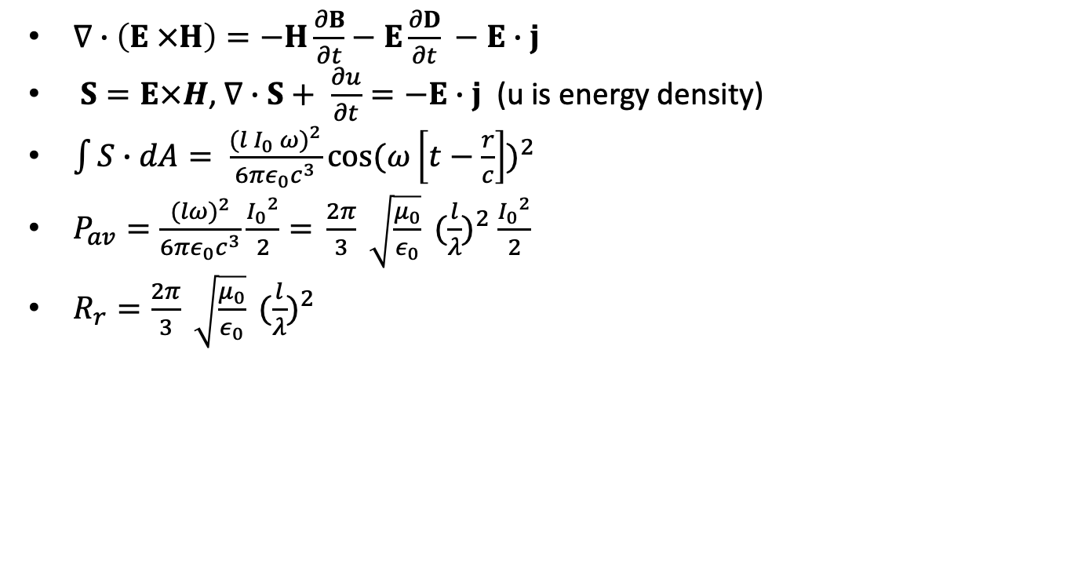
Radiation from a small dipole
$∇∙\left(E ×H\right)=−H\frac{∂B}{∂t}−E\frac{∂D}{∂t} −E∙j$
$S=E×H$, $∇∙S+ \frac{∂u}{∂t}=−E∙j$ (u is energy density)
$\int{S∙dA= \frac{{(l I_{0} ω)}^{2}}{6πε_{0}c^{3}}{{cos⁡(ω\left[t−\frac{r}{c}\right])}^{2}}}$
$P_{av}=\frac{{(lω)}^{2}}{6πε_{0}c^{3}}\frac{{I_{0}}^{2}}{2}{=} \frac{2π}{3} \sqrt{\frac{μ_{0}}{ε_{0}}} {(\frac{l}{λ})}^{2} \frac{{I_{0}}^{2}}{2}$
$R_{r}=\frac{2π}{3} \sqrt{\frac{μ_{0}}{ε_{0}}} {(\frac{l}{λ})}^{2}$

Slide 33
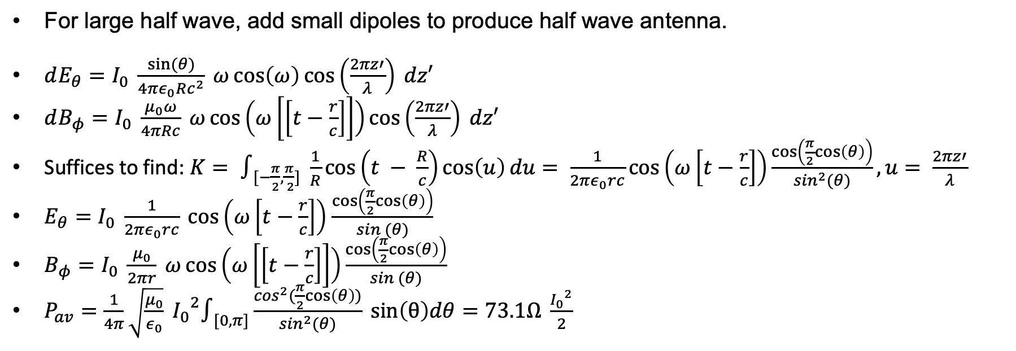
Large half wave dipole
For large half wave, add small dipoles to produce half wave antenna.
$dE_{θ}=I_{0} \frac{sin⁡(θ)}{4πε_{0}Rc^{2}} ω\cos\left(ω\right)\cos\left(\frac{2πz′}{λ}\right) dz′$
$dB_{φ}=I_{0} \frac{μ_{0}ω}{4πRc} ω\cos\left(ω\left[\left[t−\frac{r}{c}\right]\right]\right)\cos\left(\frac{2πz′}{λ}\right) dz′$
Suffices to find: $K= ∫_{[−\frac{π}{2},\frac{π}{ 2}]} \frac{1}{R}\cos\left(t − \frac{R}{c}\right)\cos\left(u\right)du= \frac{1}{2πε_{0}rc}\cos\left(ω\left[t−\frac{r}{c}\right]\right)\frac{\cos\left(\frac{π}{2}cos\left(θ\right)\right)}{\sin^{2}(θ)}, u= \frac{2πz′}{λ}$
$E_{θ}=I_{0} \frac{1}{2πε_{0}rc} \cos\left(ω\left[t−\frac{r}{c}\right]\right)$ $\frac{\cos\left(\frac{π}{2}cos\left(θ\right)\right)}{sin (θ)}$
$B_{φ}=I_{0} \frac{μ_{0}}{2πr} ω\cos\left(ω\left[\left[t−\frac{r}{c}\right]\right]\right)\frac{\cos\left(\frac{π}{2}cos\left(θ\right)\right)}{sin (θ)}$
$P_{av}=\frac{1}{4π}\sqrt{\frac{μ_{0}}{ε_{0}}} {I_{0}}^{2}∫_{[0, π]}\frac{\cos^{2}(\frac{π}{2}cos\left(θ\right))}{\sin^{2}(θ)} sin\left(θ\right)dθ=73.1Ω \frac{{I_{0}}^{2}}{2}$

Slide 34
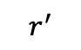




Radiation from charge distribution
$r^{′}+R=r$, $R=|r−r^{′}|$
$φ\left(r,t\right)=\frac{1}{4πε_{0}}∫_{V_{1}}\frac{ρ(r^{′}, t−\frac{R}{c})}{|r−r^{′}|}dv^{′}= \frac{1}{4πε_{0}}\left[\frac{Q}{r}+ \frac{r∙p(t−\frac{r}{c})}{r^{3}}+ \frac{r∙\frac{dp}{dt}(t−\frac{r}{c})}{cr^{2}}\right]$
$A\left(r,t\right)=$ $\frac{μ_{0}}{4π}∫_{V_{1}}\frac{j(r^{′}, t−\frac{R}{c})}{|r−r^{′}|}dv^{′}= \frac{μ_{0}}{4πr} \frac{d}{dt}p(t−\frac{r}{c})$
$E=−\frac{∂A}{∂t}−∇φ$
$B\left(r,t\right)=\frac{−μ_{0}}{4πcr^{2}}r ×\ddot{p}(t−\frac{r}{c})$
$E\left(r,t\right)=−\frac{c}{r}r× B\left(r,t\right)$
$\frac{dp}{dt}=q\frac{dr^{′}}{dt}=qv, \frac{d^{2}}{{dt}^{2}}p(t−\frac{r}{c})=q\frac{dv}{dt}$
$S= \frac{1}{μ_{0}}E×B=\frac{{\ddot{p}}^{2} {sin⁡(θ)}^{2}}{16π^{2}ε_{0}c^{3}r^{r}}\frac{\vec{r}}{r}$
$P_{R}=−\frac{dW}{dt}= \frac{2}{3}\frac{q^{2}}{4πε_{0}c^{3}}{(\frac{dv}{dt})}^{2}$
Compare to Feynman later
$$1$$
$$R$$
$$r$$
$$r^{′}$$
(0,0)

Slide 35

Radiation from a single accelerating charge
Near zone
$φ\left(r,t\right)=\frac{q}{4πε_{0}}\left[\frac{1}{R′(1+\frac{v∙n^{′}}{c})}\right]$
$R^{∗}=R^{′}−\frac{v}{c}(x_{0}−{x′}_{1})$
$E\left(r,t\right)=\frac{1}{4πε_{0}}\frac{1}{R^{∗3}}[\left(R^{′}− \frac{R^{′} v^{′}}{c}\right)\left(1− \frac{v^{2}}{c^{2}}\right)+ \frac{R′}{c^{2}}\left(R′ − \frac{R^{′}v^{′}}{c}\right)× \frac{dv^{′}}{dt}]$
$B= \frac{R^{′}×E}{R^{′}c}$
$S= \frac{q^{2}}{16π^{2}c^{3}ε_{0}} \frac{R^{′}{(R^{′}×v^{′})}^{2}}{{(R^{′})}^{5}}$

Slide 36


Feynman’s Treatment - 1
Want to derive the Heaviside-Feynman equation:
$E= \frac{q}{4πε_{0}}[\frac{e_{r′}}{r^{′2}}+\frac{r^{′}}{c}\frac{d}{dt}\frac{e_{r′}}{r^{′2}}+\frac{1}{c^{2}}\frac{d^{2}e_{r′}}{{dt}^{2}}]$
$cB=e_{r^{′ }}×E$
Solution to Maxwell:
$E=−∇φ−\frac{∂A}{∂t}$, $B=∇×A$
$∇^{2}φ−\frac{1}{c^{2}}\frac{∂^{2}φ}{{∂t}^{2}}=−\frac{ρ}{ε_{0}}$, $∇^{2}A−\frac{1}{c^{2}}\frac{∂^{2}A}{{∂t}^{2}}=−\frac{j}{c^{2}ε_{0}}$
With gauge $∇∙A=−\frac{1}{c^{2}}\frac{∂φ}{∂t}$
Consider solution to $∇^{2}ψ−\frac{1}{c^{2}}\frac{∂^{2}ψ}{{∂t}^{2}}=−s$
First solve $∇^{2}ψ−\frac{1}{c^{2}}\frac{∂^{2}ψ}{{∂t}^{2}}=$0
The solution of $\frac{∂^{2}φ}{{∂x}^{2}}− \frac{1}{c^{2}}\frac{∂^{2}φ}{{∂x}^{2}}=0$ is
$φ\left(x,t\right)=Af\left(x−ct\right)+Bg\left(x+ct\right)$
$\frac{∂ψ(r)}{∂x}= ψ^{′}\frac{∂r}{∂x}$ and $\frac{∂r}{∂x}=\frac{x}{r}$
$\frac{∂^{2}ψ}{{∂x}^{2}}=ψ^{′′}{(\frac{∂r}{∂x})}^{2}+ψ^{′}\frac{∂^{2}r}{{∂x}^{2}}$ and $\frac{∂^{2}r}{{∂x}^{2}}=\frac{1}{r}(1−\frac{x^{2}}{r^{2}})$
So, $\frac{∂^{2}ψ}{{∂x}^{2}}+\frac{∂^{2}ψ}{{∂y}^{2}}+\frac{∂^{2}ψ}{{∂z}^{2}}=ψ^{′′}+\frac{2}{r}ψ^{′}$
$∇^{2}\left(rψ\right)−\frac{1}{c^{2}}\frac{∂^{2}\left(rψ\right)}{{∂t}^{2}}=0$
So, $ψ\left(x,t,z,t\right)=\frac{f(t−\frac{r}{c})}{r}$

Slide 37

Feynman’s Treatment - 2
As $r→0,ψ\left(x,t,z,t\right)=\frac{f(t)}{r}$.
Consider the electrostatic case where $∇^{2}φ=−\frac{ρ}{ε_{0}}$ where $φ= \frac{q}{4πε_{0}r}.$
By analogy:
$f\left(t−\frac{r}{c}\right)= \frac{S(t−\frac{r}{c})}{4π}$
$S= \int{s dV}$
So, solution is: $ψ\left(x,t,z,t\right)=\frac{1}{4π}\frac{S(t−\frac{r}{c})}{r}$. Thus,
$A\left(1,t\right)= \int{\frac{\vec{j}\left(2, t−\frac{r_{12}}{c}\right)}{4πε_{0}c^{2}r_{12}}} dV_{2}$
$φ\left(1,t\right)= \int{\frac{ρ\left(2, t−\frac{r_{12}}{c}\right)}{4πε_{0}r_{12}}} dV_{2}$
$E=−∇φ−\frac{∂A}{∂t}$, $B=∇×A$
With gauge $∇∙A=−\frac{1}{c^{2}}\frac{∂φ}{∂t}$

Slide 38

Feynman’s Treatment - 3
For small blob of charge moving with velocity v, $j=vρ$.
$A\left(1,t\right)= \int{\frac{\vec{j}\left(2, t−\frac{r_{12}}{c}\right)}{4πε_{0}c^{2}r_{12}}} dV_{2}=\frac{1}{r}\int{vρdV_{2}=\frac{qv}{r}}$
So, for a dipole with $\vec{p}\left(r,t\right)=qd\vec{k}, \frac{qv}{r}= \frac{∂\vec{p}}{∂t}$
$A\left(1,t\right)=\frac{\dot{p}(t−\frac{r}{c})}{4πε_{0}c^{2}r}, B=∇×A$ and $B_{z}=0$. $A$ is due to dipole current. If the dipole charges oscillate $p\left(t\right)=p_{0}\sin\left(ωt\right)$, $A_{z}\left(1, t\right)=\frac{1}{4πε_{0}c^{2}r} p_{0}ωcos⁡(ω[t−\frac{r}{c}])$
$B_{x}=\frac{∂A_{z}}{∂y}=\frac{1}{4πε_{0}c^{2}r}\frac{∂\dot{p}(t−\frac{r}{c})}{∂y}.$
$B_{y}=−\frac{∂A_{z}}{∂x}=−\frac{1}{4πε_{0}c^{2}r}\frac{∂\dot{p}(t−\frac{r}{c})}{∂x}$
$B_{x}=\frac{1}{4πε_{0}c^{2}r}\left[−\frac{y\left(t−\frac{r}{c}\right)}{r^{3}}−\frac{y\ddot{p}\left(t−\frac{r}{c}\right)}{{cr}^{2}}\right], B_{y}=\frac{1}{4πε_{0}c^{2}r}[\frac{x\dot{p}\left(t−\frac{r}{c}\right)}{r^{3}}+\frac{x\ddot{p}\left(t−\frac{r}{c}\right)}{{cr}^{2}}]$

Slide 39

Feynman’s Treatment - 4
Rewrite previous equation as
$\vec{B}=\frac{1}{4πε_{0}c^{2}r^{3}}\left[\dot{p}\left(t−\frac{r}{c}\right)+\frac{r}{c}\ddot{p}\left(t−\frac{r}{c}\right)\right]× r$
Compare this to Biot Savart: $dB=\frac{1}{4πε_{0}c^{2}}\frac{j×r}{r^{3}}dV$
Now suppose the dipole charges oscillate $q\left(t\right)=q_{0}\sin\left(ωt\right)$
When $\frac{r}{c}$ is small, $\dot{p}\left(t−\frac{r}{c}\right)= \dot{p}\left(t\right)−\frac{r}{c}\ddot{p}\left(t\right)+ …$
$E⊥B$, $E=cB$ and from $\frac{∂φ}{∂t}=−∇∙A$, we get
$φ=\frac{1}{4πε_{0}r^{3}}\left[p\left(t−\frac{r}{c}\right)+\frac{r}{c}\dot{p}\left(t−\frac{r}{c}\right)\right]∙r$, and
$E=−∇φ−\frac{∂A}{∂t}=\frac{1}{4πε_{0}c^{2}r^{3}}[\frac{3\left(p^{∗}∙r\right)\vec{r}}{r^{2}}+\frac{1}{c^{2}}(\ddot{p}\left(t−\frac{r}{c}\right)×r×r)]$ where
$p^{∗}=p\left(t−\frac{r}{c}\right)+\frac{r}{c}\dot{p}\left(t−\frac{r}{c}\right)$

Slide 40

Lienard-Wierchert
$φ\left(1,t\right)= \int{\frac{ρ\left(2, t−\frac{r_{12}}{c}\right)}{4πε_{0}r_{12}}} dV_{2}$
$φ\left(1,t\right)=\sum{\frac{ρ_{i}∆V_{i}}{{r_{i}}^{′}}}=\sum{\frac{ρwa^{2}}{r^{′}}}=\frac{ρa^{3}}{r^{′}}\frac{Nw}{a}=\frac{q}{r^{′}}\frac{b}{a}$
$b=a+\frac{v}{c}b$
So, we get
$φ\left(1,t\right)=\frac{q}{4πε_{0}{[r−\frac{v∙r}{c}]}_{ret}}$ and
$A\left(1,t\right)=\frac{qv_{ret}}{4πε_{0}c^{2}{[r−\frac{v∙r}{c}]}_{ret}}$
Now we can compute $E$ as above and verify the Heaviside formula
a
1
r₁
…
1
2
N
v
a
…
1
2
N
r_{N}
b

Slide 41

Radiation loss and antenna aperture
Spreading loss: $L_{s}=32+log\left(d\right)+20 log\left(f\right)$
d in kilometers
F in megahertz
$W= A_{e}P_{e}$, $A_{e}=\frac{λ^{2}}{4π}$

Slide 42


Antenna aperture
Deriving antenna aperture uses thermodynamic argument: black body equilibrium
$P_{A}= \frac{A_{e}}{2}B_{υ}Δν∫_{[0,4π]} dΩ=2π A_{e}B_{υ}Δν$
$B_{υ}= \frac{2ν^{2}kT}{c^{2}}= \frac{2kT}{λ^{2}}$ (Rayleigh-Jeans)
$P_{R}=kTΔν$
$P_{A}=P_{R}$
$A_{e}=\frac{λ^{2}}{4π}$
P_{A}
P_{R}
A
R
T
T
Filter[$ν,ν$+ $Δν]$

Slide 43

Impedance matching
L networks, $π$and T networks
Impedance and reflection coefficients

Slide 44

GPS
Space Segment
31 operating satellites (Current generation: block IIIA – 2018)
12 hour orbits MEO (21000km), 8-12 satellites in view
Transmitter power: 44.8* W, $G_{t}=12dBi$. Clocks accurate to better than 10ns (no leap seconds).
Control segment master at Schriever AFB (plus alternative master, 4 ground antennas and 6 ground stations). Ephemeris updates daily.
User segment
Two bands: L1 (1575.42 MHz [2.046MHz BW]) civilian and military, L2 (1227.6MHz)], military only
Two signals: C/A (civilian) and P(Y) (military). C/A signal is Direct Sequence Spread Spectrum
Satellite identified by PRN (1-32).
L1 signal: $s\left(t\right)= A_{c}C\left(t\right)D\left(t\right)\cos\left(ω_{c}t+θ_{1}\right)+A_{p}P\left(t\right)D\left(t\right)\sin\left(ω_{c}t+θ_{2}\right)$
$C\left(t\right)$ - coarse ranging code
$D\left(t\right)$ - navigation signal consists of (clock, ephemeris, almanac corrections) 37,500 bits. 50 bps transmission.
$P\left(t\right)$ - precision ranging (Y is encrypted)
* This is total transmitter power, 27 W devoted to ranging code. Newer satellites have higher power and can surge power

Slide 45

Some data and rough calculations
$N=kTB, k=1.38×{10}^{−23} J/K$. BW: $2.046MHz$
For comparison: laptop emission noise density is capped at ${10}^{−7}\frac{W}{MHz}$
Noise:$1.38×{10}^{−23}\frac{J}{K}×100×2×{10}^{6}=2.76 ×{10}^{−15}W,$ ($−145.6 dB$)
Free space loss (@100K): $P_{r}=\frac{P_{t}GA}{4πr^{2}}.$ $\int{AdΩ}=λ^{2}.$ $P_{r}=\frac{(44.7){10}^{1.24}}{4π{(21×{10}^{6})}^{2}}×\frac{3×{10}^{8}}{1.575×{10}^{9}}=4×{10}^{−15}W$($−144dB$)
Final SNR: $−144+145.6+43=44.6dB.$
Lower in practice since satellite not directly overhead, and there are shadowing and multipath losses. In addition, we have receiver loss (and receiver antenna gain) so $P_{r}$ could be as small as $−170dB$ and final SNR is approximately $−170+144+43=17dB$
Receiver modeled at $G_{r}=2dBi$

Slide 46


Signal Structure

Slide 47

GPS spectrum neighborhood

Slide 48

Signal Summary

Slide 49

L1 Signal Structure
$s_{m}\left(t\right)=C\left(t\right)⊕D\left(t\right)$. $s\left(t\right)={A_{c}s}_{m}\left(t\right)cos⁡(ω_{c}t+θ_{1})$ [bspk]
D(t) - 50 bps transmission (20ms).
C(t) – 1 Mbps chipping rate. 300 meters, $1μs/chip$. Chipping code repeats 20 times for single navigation bit.
C/A code is generated from two Gold codes and the PRN identifier (5 bits).
$g_{1}\left(x\right)=1+ x^{3}+x^{10}$, $g_{2}\left(x\right)=1+x^{2}+x^{3}+x^{8}+x^{9}+x^{10}$
Phase selector takes PRN and uses it to select bits of the second Gold code.
Signal Characteristics
Received power: -130dBm, Noise power: -111dBm
Spread spectrum contributes 43 dB to processing. Want SNR greater than 14 dB
SNR for C/A: -20dB

Slide 50
Acquisition, tracking and navigation
Acquisition
Receiver generates known C/A code and attempts to correlate with signal.
To generate C/A code, receiver needs to know which satellite it’s attempting to acquire to determine code
Tracking via delay loop to maintain C/A code alignment
The Navigation Message includes the Ephemeris parameters, the Time parameters and Clock Corrections, the Service Parameters with satellite health information, Ionospheric parameters model, and the Almanacs, allowing the computation of the position of ”all satellites in the constellation”. The ephemeris and clocks parameters are usually updated every two hours, while the almanac is updated at least every six days.

Slide 51
Navigation Message
The navigation message contains 25 pages (’frames’) of 30 seconds each. Entire message takes 12.5 minutes to be transmitted. Every frame is subdivided into 5 sub-frames of 6 seconds each; every sub-frame consists of 10 words, with 30 bits per word.
Every sub-frame starts with the telemetry word (TLM), needed for synchronism. Next, the transference word (HOW) which provides time information (seconds of the GPS week), allowing the receiver to acquire the week-long P(Y)-code segment.
Sub-frame 1: contains information the satellite clock. It also has information about satellite health condition.
Sub-frames 2 and 3: contain satellite ephemeris.
Sub-frame 4: provides ionospheric model parameters, UTC information (Universal Coordinate Time), part of the almanac, and indications whether the Anti-Spoofing, A/S, is activated.
Sub-frame 5: contains data from the almanac and the constellation status. It allows to quickly identify the satellite from which the signal comes. A total of 25 frames are needed to complete the almanac.
Sub-frames 1, 2 and 3 are transmitted with each frame. The content of sub-frames 4 and 5 is common for all satellites. So, the almanac data for all in orbit satellites can be obtained from a single tracked satellite.

Slide 52

Processing and Accuracy
For satellite k: $ρ=\sqrt{{(x^{(k)}−x)}^{2}+{(y^{(k)}−y)}^{2}+{(z^{(k)}−z)}^{2}}$
Need to account for skew between satellite clocks and receiver clock. b is receivers clock bias
Four satellites required. More satellites increase precision with least squares.
Doppler correction improves accuracy
Carrier-Phase Enhancement corrects timing errors caused by non-zero PRN pulse transition.
It uses the L1 carrier wave, which has a period about one-thousandth of the C/A Gold code bit providing an additional clock.
The phase difference error in the normal GPS amounts to 2–3 m error. Carrier-Phase Enhancement reduces this to 3 cm (1.2 in).
Differential GPS

Slide 53







Carrier phase
$∆r=d\cos\left(θ_{0}\right)$
Wave arrives at B first. Arrives at A with phase delay $φ_{0}= ⇂φ_{0}⇃+Δ_{0}$, so
$d\cos\left(θ_{0}\right)= λ(φ_{0})$
Satellite moves in time $t_{1}$changing angle to $θ_{1}$
Suppose$⇂φ_{0}⇃= ⇂φ_{1}⇃=N$, and put $d^{′}=\frac{d}{λ}$
$d^{′}\cos\left(θ_{0}\right)−N= Δ_{0}$
$d^{′}\cos\left(θ_{1}\right)−N= Δ_{1}$
We can solve for $N,d^{′}$
Now, $φ=λ^{−1}\left[r−I+T\right]+f∙\left(δt_{u}−δt^{s}\right)+N+ε_{φ}$
I is ionospheric delay, T is tropospheric delay which we can estimate.
$ε_{φ}≈.025 cycles$ (5mm), so we can recover $r$ to mm precision
$$Δr_{0}$$
$$θ_{0}$$
$$A$$
$$d$$
$$B$$

Slide 54
GPS receiver
Code
NCO
IF
Phase rotation
LNA
X
A/D
Correlator
Accumulator

Slide 55
More careful estimates*
Elevation | 5º | 40º | 90º
Power at sat input | 14.3dB | 14.3dB | 14.3dB
Sat antenna gain | 12.1dB | 12.9dB | 10.2dB
EIRP | 26.4dB | 27.2dB | 24.5dB
Range | 25240km | 22020km | 20190km
Path loss | -159 dB/m² | -157.8 dB/m² | -157.1 dB/m²
Atmo loss | .5dB | .5dB | .5dB
Received power density | -133.1dB/m² | -131.1dB/m² 7.8x10⁻¹⁴ W/m² | -133.1dB/m² 4.9x10⁻¹⁴ W/m²
*Misra and Enge, GPS

Slide 56
More careful estimates*
Elevation | 5º | 40º | 90º
Received power density | 4.9x10⁻¹⁴W/m² | 7.8x10⁻¹⁴W/m² | 4.9x10⁻¹⁴W/m²
Effective area of receiver | 2.7 x 10⁻³m² -24.5dBm² | 2.7 x 10⁻³m² | 2.7 x 10⁻³m²
Isotropic receiver power | -158.5 dB | -156.5dB | -158.5dB
G_{r} | -4 dBic | 2 dBic | 4dBoc
C/A received power | -162.5dB | -154.5dB | -154.5dB
*Misra and Enge, GPS

Slide 57

More careful estimates*
Noise loss
Elevation | Ant cable | LNA | cable
Gain | -1dB | 20dB | -10dB
F | 1dB | 2-3dB | 10dB
T | 75.4 | 290 | 2610
$−162.5dB≤C≤−154.5dB$
$P_{N}=N_{0}(2×{10}^{7})$
$σ_{Δτ}=cT_{c}\sqrt{\frac{d}{4TC/{N_{0}}}}$ where $τ$ is the noise sample interval, $d$ is the correlator interval, $T$ is the averaging time, $d$ is measured in chips and so $dT_{c}$is the time sampling
SNR
Elevation | 5º | 90º
Received C/A power (C) | -162.5dB | -154.5dB
N₀ for 3dB LNA | -201 W/Hz | -201W/Hz
C/N₀ | 34.5 db-Hz | 46.5 dBHz
C/P_{n} 20MHz | -34.6 dB | -26.5dB
C/P_{n} 2MHz | -24.5dB | -16.5dB
*Misra and Enge, GPS

Slide 58
Supplement

Slide 59

Modulation
AM: $V\left(t\right)=(1+am\left(t\right))V_{c}cos\left(ω_{c}t\right)$
FM: $V\left(t\right)=V_{c}cos⁡({[ω}_{c}+am\left(t\right)]t)$
Angle: $V\left(t\right)=V_{c}\cos\left(ω_{c}t+φ\left(t\right)\right),φ\left(t\right)=am(t)$. [Like FM]
FSK: $V\left(t\right)= V_{c}cos⁡(ω_{1}t)$, if 1 [mark]; $V_{c}cos⁡(ω_{0}t)$, if 0 [space]
PSK: $V\left(t\right)= V_{p}cos⁡(ω_{c}t)$, if 1; ${−V}_{p}cos⁡(ω_{c}t)$, if 0 [space]
Gain: $G=\frac{P_{o}}{P_{i}}$, Loss: $L=\frac{P_{o}}{P_{max}}$, Rejection: $R=\frac{P_{max}}{P_{pb}}.$
$P_{s}=\int{σ E∙E+ ε\frac{E∙E}{2}+\frac{H∙H}{2μ}} dV+ \int{E×H dA}$

Slide 60


Direct conversion receivers
Mixer
$V\left(t\right)=\cos\left(ω_{1}t\right)\cos\left(ω_{2}t\right)= \frac{1}{2}[\cos\left(\left(ω_{1}+ω_{2}\right)t\right)+\cos\left(\left(ω_{1}−ω_{2}\right)t\right)]$
Image frequency
$ω_{vi}=ω_{LO}+ω_{a}$
$ω_{rf}=ω_{LO}−ω_{a}$
RF filter removes image
Downside:
Not tunable
RF
Filter
$$⊗$$
RF Mixer
LO
Audio
Amp
Direct conversion
audio
RF
LO
image

Slide 61



Norcal 40A
7 MHz
2W
<10 MHz
Harmonic
Filter
RF
Filter
Power
Amp
7 MHz
$$⊗$$
RF Mixer
20 mW
4.9 MHz, 9.1 MHz
Driver
IF Filter
300 uW
VFO
2.1 MHz
4.9 MHz
Product
Detector
Buffer
$$⊗$$
BFO
4.9 MHz
10 uW
Transmit
Filter
9.8 MHz, Audio
AGC
7 MHz
2.8 MHz
$$⊗$$
Transmit
Mixer
AGC
Detector
Audio
Amp
Key
Transmit oscillator
4.9 MHz

Slide 62



Mixers
$V_{lo}(t)$ is a square wave with period $ω_{lo}$. Expanding this in a Fourier series, we get:
$V_{lo}\left(t\right)= \frac{4}{π}(\cos\left(ω_{lo}t\right)−\frac{\cos\left(3ω_{lo}t\right)}{3}+\frac{\cos\left(5ω_{lo}t\right)}{5}…)$, $V_{rf}\left(t\right)=V_{rf}cos⁡(ω_{rf}t)$
$V_{lo}\left(t\right)V_{rf}\left(t\right)=\frac{2V_{rf}}{π}\left({cos⁡(ω}_{−}t\right)−\frac{\cos\left(3ω_{−}t\right)}{3}+\frac{\cos\left(5ω_{−}t\right)}{5}…)$ + $\frac{2V_{rf}}{π}\left({cos⁡(ω}_{+}t\right)−\frac{\cos\left(3ω_{+}t\right)}{3}+\frac{\cos\left(5ω_{+}t\right)}{5}…)$
$ω_{+}=ω_{lo}+ω_{rf}$ and $ω_{−}=|ω_{lo}−ω_{rf}|$
We define $ω_{k+}={(kω}_{lo}+ω_{rf})$ and $ω_{k−}=|{kω}_{lo}−ω_{rf}|$ and $V_{k+}\left(t\right)=\frac{2V_{rf}}{kπ}cos⁡(ω_{k+}t)$ and $V_{k−}\left(t\right)=\frac{2V_{rf}}{kπ}cos⁡(ω_{k−}t)$
$ω_{i}=ω_{if}−ω_{lo}$ and $ω_{if}=ω_{if}+ω_{i}$ , $ω_{i}$ is a spurious signal. $ω_{k+}$ and $ω_{k−}$ are the spurs from the $k$th harmonic
LO
Image
IF
RF
$$3↑$$
$$5↑$$

Slide 63

Phasors
$V\left(t\right)=RI\left(t\right)$
$V\left(t\right)=L\dot{I}\left(t\right)$
$I\left(t\right)=C\dot{V}\left(t\right)$
Suppose $V\left(t\right)=Acos(ωt+θ)$ and $I\left(t\right)=Bcos(ωt+φ)$ . If $φ>θ$, we say the current leads the voltage.
$V\left(t\right)=Re(e^{j(ωt+θ)})$, and $I\left(t\right)=Re(e^{j(ωt+φ)})$
Now define $V=Ae^{jθ}$ and $I=Be^{jφ}$, so $\left|V\right|=A$, $\left|I\right|=B$, $∠V=θ$, and $∠I=φ$. $V$ and $I$ are called phasors and do not include time. Note that $V\left(t\right)=Re(Ve^{jωt})$ and $I\left(t\right)=Re\left(Ie^{jωt}\right)$.
Note that $I=CVjω$, for a capacitor and $V=LIjω$, for an inductor
$\hat{V}=Z\hat{I}$, $Z=R+jX$
$\hat{I}=Y\hat{V}$, $Y=G+jB$

Slide 64

Resonance and Q
Series Resonance
At $ω_{u}$ and $ω_{l}$, $X=±R$ [$ω_{u}$ is upper 3dB cutoff and $ω_{l}$ is lower 3dB cutoff]
$ω_{u}L−\frac{1}{ω_{u}C}=R$, $ω_{l}L−\frac{1}{ω_{l}C}=−R$
Define $Q=\frac{X}{R}$
$\frac{ω_{u}}{ω_{0}}−\frac{ω_{0}}{ω_{u}}=\frac{R}{ω_{0}L}= \frac{1}{Q}$ and $\frac{ω_{l}}{ω_{0}}−\frac{ω_{0}}{ω_{l}}=−\frac{R}{ω_{0}L}$ $=−\frac{1}{Q}$
$\frac{ω_{u}}{ω_{0}}−\frac{ω_{0}}{ω_{u}}=\frac{ω_{0}}{ω_{l}}−\frac{ω_{l}}{ω_{0}}$, so ${ω_{0}}^{2}=ω_{u}ω_{l}$ and $\frac{ω_{u}−ω_{l}}{ω_{0}}=\frac{1}{Q}$
Parallel Resonance
$\frac{ω_{u}}{ω_{0}}−\frac{ω_{0}}{ω_{u}}=\frac{G}{ω_{0}C}= \frac{1}{Q_{p}} \text{and} \frac{ω_{l}}{ω_{0}}−\frac{ω_{0}}{ω_{l}}=−\frac{G}{ω_{0}C} =−\frac{1}{Q_{p}}$

Slide 65

Power
$P\left(t\right)=I\left(t\right)V\left(t\right)$
Complex power: $P=\frac{V\overline{I}}{2}=Z\frac{{|I|}^{2}}{2}= P_{a}+jP_{r}=R\frac{{|I|}^{2}}{2}+jX\frac{{|I|}^{2}}{2}$
$P_{a}$ is power delivered to resistor, $P_{r}$ is power stored in inductor and capacitor
$P_{r}=\frac{ωL{|I|}^{2}}{2}−\frac{ωC{\left|V_{c}\right|}^{2}}{2}= ω(E_{L}−E_{C})$
$Q= ω\frac{L{|I|}^{2}}{R{|I|}^{2}}=ω\frac{L}{R}= ω\frac{E_{L}}{P_{a}}$

Slide 66


Op Amp models
X₁
$$⊕$$
A
X₂
$A\left(f\right)= \frac{A_{0}}{1+j(f/{f_{0}})}$
$A\left(X_{1}−BX_{2}\right)=X_{2}$ so $\frac{X_{2}}{X_{1}}=K=\frac{A}{1+AB}$
$\frac{dK}{dA}= \frac{1}{{(1+AB)}^{2}}$
$AB<0$, positive feedback
$AB>0$, negative feedback
For 741, $Z_{i}≈2×{10}^{6}Ω$, $Z_{o}≈150Ω$
B
Feedback
Z_{o}
Z_{i}
-Av_{i}
+

Slide 67

Op Amps
Ideal op amp
$Z_{in}=∞$
$A_{V}=\frac{V_{o}}{V_{i,+}−V_{i,−}}$, $A_{V}$ is an op amp parameter between ${10}^{4}$ and ${10}^{6}$.
$V_{−}=V_{+}$ for negative feedback
Output voltage increases when $v_{+}>v_{−}$, decreases when $v_{+}<v_{−}.$
Example 1: Inverting amp, we’ll show the gain is $\frac{R_{2}}{R_{1}}$
$i_{1}=\frac{V_{in}}{R_{1}}$, $i_{2}=\frac{V_{out}}{R_{2}}$ since the op amp has infinite input impedance
By Kirchhoff, $i_{1}=−i_{2}$, so $V_{out}=\frac{R_{2}}{R_{1}} V_{in}$
$Z_{in}=R_{1}$
$Z_{out}$ is same as non-inverting.
Example 2: Non-inverting amp
$V_{−}=V_{+}$, so $V_{out}=(1+\frac{R_{2}}{R_{1}}) V_{in}$
$Z_{in}>{10}^{6}Ω$
$Z_{out}=\frac{R_{o,Th}}{1+A_{V}β}$, $β= \frac{R_{2}}{R_{1}+R_{2}}$, $R_{o,Th}$ is the Thevenin resistance of the op amp
R₁
R₂
v_{in}
-
Inverting
+
v_{out}
R₁
R₂
-
Non-inverting
+
v_{out}
v_{in}

Slide 68






Miscellaneous op amps
Schmidt trigger
Smoothing
V_{in}
-
V_{out}
C
R
+
R₁
$RC=\frac{10}{f}$
R₂
$R_{1}>R_{2}$
$\left(V_{Th,+}−V_{Th,−}\right)=\frac{R_{2}}{R_{1}+R_{2}}(V_{sat,+}−V_{sat,−})$
Simple op amp model
$\frac{1}{g(f)}=\frac{1}{g_{DC}}+j\frac{f}{f_{BW}}$
LM324

Slide 69
358 op amp
Square wave
Peak
.001uF
100K
V_{in}
-
V_{out}
.05uF
VCO
-
V_{out}
LM358
LM358
+
100K
sawtooth
100K
+
V_{ref}
-
V_{in}
100K
LM358
-
square
V_{c}
51K
+
LM358
V_{c}/2
100K
+
51K
51K
50K
100K
10K

Slide 70
Op integrators and differentiators and differential amp
Integrator
Differentiator
R₁=10K
-
-
+
+
V_{in}
R_{i}
R_{f}
-
V_{out}
R_{i}
+
V_{in}
R_{f}
Differential amp

Slide 71


Real 358 based ops
R_{f}=100K
R₁=100K
1M=R₂
Inverting Amp
R₁=10K
.1uF
-
-
LM358
LM358
100K
Non inverting Amp
+
+
6.2K
10K
6.2K
10K
V_{in}
V_{in}
100K
1M
$$A_{v}=1+\frac{R_{2}}{R_{1}}$$
10uF
100K
$$A_{v}=\frac{R_{f}}{R_{1}}$$
V_{c}
100K
10uF

Slide 72

Op amp feedback
i₁
v₁
+
A
-
v₂
R₁
Nyquist
Polar plot of AB
R₂
$v_{−}=v_{2}\frac{R_{2}}{R_{1}+R_{2}}$
$v_{2}=A\left(v_{1}−v_{2}\frac{R_{2}}{R_{1}+R_{2}}\right)$
$\frac{v_{2}}{v_{1}}=\frac{A}{1+A\frac{R_{2}}{R_{1}+R_{2}}}=\frac{A}{1+AB}$
$K=\frac{A}{1+AB}$
$\frac{dK}{dA}=\frac{1}{{(1+AB)}^{2}}$

Slide 73
Current to voltage
-
i₁
R₂
+
v₂

Slide 74



Oscillation conditions
B
$$⨂$$
A
-
v₂
+
A
B
-
v₂
Oscillation: $AB=1∠180$
Oscillation: $AB=1∠0$

Slide 75




Some filter transfer functions
High pass
Low pass
Wein
C
R
C
R
C
R
$$G_{HP}=\frac{1}{1+\frac{ω_{0}}{jω}}$$
$$G_{LP}=\frac{1}{1+j\frac{ω}{ω_{0}}}$$
$\frac{v_{2}}{v_{1}}= \frac{1}{\begin{aligned}3+j(ωCR−\frac{1}{ωCR}) \\ \end{aligned}}$
Oscillation when $ωCR=1$
$\tan\left(φ\right)= \frac{−R_{1}R_{2}(ωCR−\frac{1}{ωCR})}{R_{1}+R_{2}}$
$\frac{dφ}{dω}=− \frac{2Q}{ω}$ so high Q improved stability
For CR ladder filter of length 3
$\frac{v_{2}}{v_{1}}= \frac{1}{1−5ω^{2}C^{2}R^{2}+j((6ωCR−ω^{3}C^{3}R^{3})}$
Phase shift is 0 when $6=ω^{2}C^{2}R^{2}$

Slide 76



Feedback networks
R
R
R
$\frac{v_{2}}{v_{1}}=1/{\left(1−5ω^{2}C^{2}R^{2}\right)+j(6ωCR−ω^{3}C^{3}R^{3})}$
C
C
C
Phase Shift Ladder
$\frac{v_{2}}{v_{1}}=\frac{1}{3}$
C
R
C
R
Wein
R₁
M
$\frac{v_{2}}{v_{1}}=(\frac{M}{L})(1/{\left(R_{1}/R_{2}+1\right)+j\left(R_{1}ωC−{R_{1}}/{\left(ωL\right)}\right)})$
R₂
C
L

Slide 77


















Modulators and detectors
Phase modulator
Simple FM detector
$$v_{cc}$$
$$v_{o}$$
$$RFC$$
$$R_{S}$$
$$L$$
$$C_{BL}$$
$$C$$
$$C$$
$$C_{L}$$
$$R_{L}$$
$$RF$$
$$v_{M}$$
$$v_{i}$$
D
$$BB$$
G
S
$$R_{2}$$
$$C_{BP}$$
$v_{o}=\frac{R}{\left(R+R_{s}\right)[1+\frac{4Q^{2}}{{ω_{0}}^{2}}{\left(ω−ω_{0}\right)}^{2}]}v_{i}$
$Q=\frac{R||R_{s}}{ω_{0}L}$
$$R_{S}$$

Slide 78
More Oscillators
Norcal VFO
9 V
10K
4.7K
9 V
Hartley
2.7 pf
D
510
47nF
G
J309
47K
47pF
47pF
D
100pf
S
200pF
G
J309
1M
MVAM108
S
L
47K
2-25pF
1.2nF
1.8K
2uF
¼ from ground
1.2nF
1mH
10nF
L: 62 turns on T68-7
19uH
150pF

Slide 79
More Oscillators
9V
Clapp
Crystal Clapp
68
Colpitts
D
D
G
G
J309
.01
100
J309
10K
out
S
S
10K
390
7MHz
2.2K
390

Slide 80
RF Amp
9V
68
68
12:3
out
.01
.01
22K
47
in
100
4.7K
270

Slide 81


PLL
+12
2
$$⊗$$
3
LPF
7
.01
10K
4
5
VCO
.01
4.7K
1
Gnd
LM565
in
10
R
2
8
10
V_{cc}
8_{R}
9_{C}
3
4.7K
C
4.7K
565
9
For general PLL, if $v_{ref}\left(t\right)= V_{R}\cos\left(ω_{0}t+φ_{R}\left(t\right)\right)$ and $v_{VCO}\left(t\right)= V_{V}cos⁡(ω_{0}t+φ_{V}\left(t\right))$, $v_{D}=k_{D}$($v_{ref}\left(t\right)−v_{VCO}\left(t\right)$) where $v_{D}$ is the output of the phase detector.
$f_{0}=.3{(RC)}^{−1}$
With no input, VCO out is about 1360Hz
For input, set function generator to 1V_{pp}
4
.022uF
5
7
+
1
VCO out
10uF
.01
-12

Slide 82
PLL FM detector
V_{cc}
With no input, out is about 1360Hz
For input, set function generator to 1V_{pp} and connect to previous 565
10K
8
4
out
7
3
.1uF
555
1uF
10K
470
6
5
Function Gen
1 V_{pp}
2
1
.1

Slide 83







Stability
Want hi Q for stability
$v_{o}=\frac{A}{1−\frac{R_{i}A}{R_{i}+R+j(ωL−1/{ωC})}}v_{i}$
$Q=\frac{ω_{0}L}{R_{i}+R}$
$$R$$
$$L$$
$$C$$
A
$$v_{o}$$
$$R_{i}$$
$$v_{i}$$

Slide 84












Miscellaneous
$$v_{i}$$
$C=Blg\left(1+SNR\right)$
$P_{n}=4kTB$
Diode: $i_{D}=i_{S}[\exp\left(\frac{V_{diode}}{nV_{T}}\right)−1]$, $V_{T}=\frac{kT}{q}$
Circuits on right
$Y=G+jB$
Capacitive Divider
$G_{in}=\frac{1}{R_{L}}{(\frac{C_{1}}{C_{1}+C_{2}})}^{2}$, $B_{in}=\frac{{ωC}_{1}C_{2}}{C_{1}+C_{2}}$
Resonant capacitive divider
${ω_{0}}^{2}= \frac{C_{1}+C_{2}}{LC_{1}C_{2}}$
$Q=\frac{R_{in}||R_{s}}{ω_{0}L}$
$$C_{1}$$
$$v_{o}$$
$$C_{2}$$
$$R_{L}$$
$$v_{i}$$
$$L$$
$$C_{1}$$
$$v_{o}$$
$$C_{2}$$
$$R_{L}$$

Slide 85

Another antenna model
$E=\frac{jωμ}{4π}I_{m}\frac{e^{jβr}}{r}$
$P_{R}=P_{B}G_{A}G_{B}{(\frac{λ}{4πr_{AB}})}^{2}$

Slide 86




Pinouts
J309

Slide 87
Morse
Symbol | Code | Symbol | Code | Symbol | Code
a | ._ | m | __ | y | _.__
b | _... | n | _. | z | __..
c | _._. | o | ___ | 0 | _____
d | _.. | p | .__. | 1 | .____
e | . | q | __._ | 2 | ..___
f | .._. | r | -_. | 3 | …__
g | __. | s | … | 4 | …._
h | …. | t | _ | 5 | …..
i | .. | u | .._ | 6 | _....
j | .___ | v | …_ | 7 | __...
k | _._ | w | .__ | 8 | ___..
l | ._.. | x | _.._ | 9 | ____.

Slide 88


Component data
Core Size | 26 | 3 | 15 | 1 | 2 | 6 | 10 | 12/17 | 0
T-12-( ) | * | 60 | 50 | 48 | 20 | 17 | 12 | 7.5 | 2.4
T-16-( ) | 145 | 61 | 55 | 44 | 22 | 19 | 13 | 8 | 3
T-20-( ) | 185 | 76 | 65 | 52 | 25 | 22 | 16 | 10 | 3.5
T-25-( ) | 245 | 100 | 85 | 70 | 34 | 27 | 19 | 12 | 4.5
T-30-( ) | 335 | 140 | 93 | 85 | 43 | 36 | 25 | 16 | 6
T-37-( ) | 285 | 120 | 90 | 80 | 40 | 30 | 25 | 15 | 4.9
T-44-( ) | 370 | 180 | 160 | 105 | 52 | 42 | 33 | 18.5 | 6.5
T-50-( ) | 330 | 175 | 135 | 100 | 49 | 40 | 31 | 18 | 6.4
T-68-( ) | 435 | 195 | 180 | 115 | 57 | 47 | 32 | 21 | 7.5
T-80-( ) | 460 | 180 | 170 | 115 | 55 | 45 | 32 | 22 | 8.5
T-94-( ) | 600 | 248 | 200 | 160 | 84 | 70 | 58 | * | 10.6
T-106-( ) | 930 | 450 | 345 | 325 | 135 | 116 | * | * | 19
T-130-( ) | 810 | 350 | 250 | 200 | 110 | 96 | * | * | 15
T-157-( ) | 1000 | 420 | * | 320 | 140 | 115 | * | * | *
T-184-( ) | 1690 | 720 | * | 500 | 240 | 195 | * | * | *
T-200-( ) | 920 | 425 | * | 250 | 120 | 100 | * | * | *
T-200A-( ) | 1600 | * | * | * | 218 | * | * | * | *
IRON POWDER TOROIDS - A_{l} Values **
* size not available in this material ** L= µH/100 turns

Slide 89

Color codes
Resistor markings in ohms
Capacitor markings in picoFarads
Inductor markings in microHenries

Slide 90
Coupling and transistor models

Slide 91
















Coupling
Voltage gain, $A$
${v_{o}=v}_{3}=A\frac{Z_{o}}{Z_{i}+Z_{o}}v_{i}$
For two stages gain is ${(A\frac{Z_{o}}{Z_{i}+Z_{o}})}^{2}$
Current gain, $A$
$i_{o}=i_{3}=A\frac{Z_{i}}{Z_{i}+Z_{o}}i_{i}$
For two stages, gain is ${(A\frac{Z_{i}}{Z_{i}+Z_{o}})}^{2}$
$$Z_{1}(=Z_{o})$$
$$Z_{3}$$
$$v_{2}$$
$$v_{i}$$
$$Z_{2}(=Z_{i})$$
$$v_{3}$$
$$Z_{4}$$
$$i_{2}$$
$$i_{4}$$
$$i_{i}$$
$$Z_{i}$$
$$Z_{o}$$
$$i_{3}$$
$$Z_{i}$$
$$Z_{o}$$

Slide 92









Power transfer
$$Z_{1}$$
Power transfer (A)
$Z_{1}=R_{1}+jX_{1}$, $Z_{2}=R_{2}+jX_{2}$
$P= {|\frac{v_{1}}{R_{1}+R_{2}+j(X_{1}+X_{2})}|}^{2} R_{2}$
Power transfer (B)
$v_{2}=\frac{v_{1}(\frac{R_{1}}{R_{1}+R_{2}})}{1+\frac{1}{jωC(R_{1}+R_{2})}}$
$$v_{1}$$
$$Z_{2}$$
A
$$R_{1}$$
$$C$$
$$v_{2}$$
$$v_{1}$$
$$R_{2}$$
B

Slide 93











Voltage responses
$$R$$
$$v_{1}$$
$$v_{2}$$
A
$$C$$
Response to square wave with width T
A: $τ=RC$, $τ=2T$
B: $τ=RC$, $τ=10T$
Overshoot below
$$C$$
$$v_{1}$$
$$v_{2}$$
$$R$$
B

Slide 94























Diodes and bipolar small signal models
Diode model: $i_{d}=i_{s}(\exp\left(\frac{eV}{kT}\right)−1)$, $\frac{e}{kT}=40V^{−1}$
$\frac{di_{d}}{dV}= i_{d}\frac{e}{kT}$, $r_{d}=\frac{e}{kT}$
$$hie$$
v$2$
v$1$
$$B$$
$$C$$
$$v2hre$$
$$i1hfe$$
$$hoe$$
$$E$$
$$E$$
$$E$$
v$2$
v$1$
$$B$$
$$C$$
$$rb$$
$$r$$
$i1hfe$ or g_{m}v₁
$$E$$
$$i1$$
$$rd$$
$$re$$

Slide 95




More on bipolar transistor model
V_{CC}
$v_{R_{2}}= v_{be}+(i_{c}+i_{b})R_{E}$
$i_{R_{2}}=\frac{v_{R_{2}}}{R_{2}}$
$i_{R_{1}}=i_{R_{2}}+i_{b}$
$v_{cc}= R_{1}i_{b}+{(R_{1}+R}_{2})i_{2}$
For $R_{B}=R_{1}||R_{2}$, $v_{cc}R_{B}−v_{be}R_{1}=R_{1}R_{2}i_{b}+(i_{c}+i_{b})R_{1}R_{E}$, $i_{c}=βi_{b}$
$i_{c}=\frac{v_{cc}\frac{R_{B}}{R_{1}}−v_{be}}{R_{E}+\frac{(R_{C}+R_{E})}{β}}$
If $R_{E}≫\frac{(R_{C}+R_{E})}{β}$, $\frac{∂i_{c}}{∂v_{be}}=−\frac{1}{R_{E}}$, be acts like diode so $i_{c}=i_{s}βexp⁡(\frac{V_{be}}{V_{T}})$. Want $V_{E}≈2v$
R₁
R_{C}
C_{o}
out
C_{i}
R_{L}
in
R₂
R_{E}
Small signal equivalent
$$βi_{b}$$
R
$$R_{L}$$
$$R=R_{1}|\left|R_{2}\right||r_{π}$$
$$r_{e}=\frac{V_{T}}{i_{c}}, r_{π}=r_{e}(β+1)$$

Slide 96


More on bipolar transistor model
V_{CC}
i_{c}
$v_{be}=v_{b}−v_{e}$, $v_{ce}=v_{c}−v_{e}$, $v_{bb}=\frac{R_{2}}{R_{1}+R_{2}}v_{cc}$, $v_{f}≈ .6$
$v_{b}=v_{e}+v_{f},$ $i_{b}=\frac{v_{bb}−v_{b}}{R_{b}}$
$i_{c}=βi_{b}+i_{ceo}$, $\frac{∂i_{b}}{∂v_{be}}=\frac{1}{r_{d}}$
$\frac{∂i_{c}}{∂v_{be}}=g_{s}=−\frac{1}{R_{B}}$, and, $\frac{∂i_{c}}{∂β}$ measure stability
$i_{b}=\frac{v_{bb}−v_{b}}{R_{b}}$
$i_{c}=\frac{β(v_{bb}−v_{be})}{R_{b}+(1+β)R_{e}}+\frac{(R_{b}−R_{e})}{R_{b}+(1+β)R_{e}}i_{ceo}$
So, if $βR_{e}≫R_{b}+R_{e}$, $i_{c}=\frac{v_{bb}−v_{be}}{R_{e}}=\frac{v_{cc}−v_{c}}{R_{c}}$
$Z_{in}=R_{1}|\left|R_{2}\right||(β+1)R_{e}$, $Z_{out}= R_{c}$
$v_{bb}−v_{be}=\frac{R_{e}}{R_{c}}(v_{cc}−v_{c}$)
Typical for Si: $v_{be}=v_{f}≈.6V, β≈200, {v_{cc}=9V, v_{bb}=3V,R}_{b}={10}^{4}Ω,R_{c}={10}^{3}Ω$, $R_{e}=270Ω$
$3−.6=\frac{270}{1000}(9−v_{c}\text{)}$, so $v_{c}=.2V$
For voltage divider: $R_{1}=2×{10}^{4}Ω, R_{2}={10}^{4}Ω,$
R₁
R_{c}
C_{o}
out
C_{i}
V_{b}
V_{c}
i_{b}
in
V_{e}
R₂
i_{e}
R_{e}
C_{e}
Equivalent
$R_{b}=R_{1}||R_{2}$
$v_{bb}=\frac{R_{1}R_{2}}{R_{1}+R_{2}}v_{cc}$
V_{CC}
i_{c}
R_{c}
C_{o}
out
C_{i}
V_{b}
in
V_{c}
i_{b}
V_{e}
V_{bb}
R_{b}
i_{e}
R_{e}

Slide 97































More on FETs
$Δi_{d}=\frac{∂i_{d}}{∂v_{GS}}Δv_{GS}+\frac{∂i_{d}}{∂v_{DS}}Δv_{DS}$
$\frac{∂i_{d}}{∂v_{GS}}=g_{d}$, $\frac{∂i_{d}}{∂v_{DS}}=g_{m}$
$Z_{in}={10}^{9}Ω$
$Z_{out}=R_{D}|\left|r_{d}\right||\frac{1}{jω(C_{GS}+C_{DS})}$
FET CS small signal equivalent
FET common source
$$D$$
$$v_{cc}$$
$${g_{m}v}_{ds}$$
$$R_{D}$$
$$r_{0}$$
$$RD$$
$$RL$$
$$G$$
$$v_{o}$$
$$S$$
$$R_{1}$$
D
$$v_{gs}$$
$$C_{BL}$$
$$RS$$
$$v_{i}$$
G
$$RG$$
$$C_{BL}$$
S
$$R_{2}$$
$$R_{E}$$
$$C_{BP}$$
$$C_{gd}$$
FET equivalent
$R_{E}$ provides bias
$\frac{v_{o}}{v_{i}}={−g}_{m}\frac{R_{D}||r_{d}}{jω(C_{GS}+C_{DS})}$
${A_{0}=−g_{m}(R}_{D}||r_{d})$
$Z_{in}=\frac{1}{jω(C_{GS}+\left(1−A_{0}\right)C_{GD})}$
$$G$$
$$D$$
$$v_{gs}$$
$$C_{gs}$$
$${g_{m}v}_{ds}$$
$$C_{ds}$$
$$r_{d}$$
$$S$$

Slide 98





















More on FETs
FET common source
$$v_{cc}$$
For common source
$R_{o}=\left[r_{d}+R_{S}\left(1+g_{m}r_{d}\right)\right]||R_{D}, R_{o}≈R_{D}$
$R_{in}=R_{G}=R_{1}||R_{2}$
$v_{in}=v_{gs}+i_{d}R_{S}=v_{gs}(1+g_{m}R_{S})$
$v_{out}=−i_{d}(R_{D}|\left|R_{L}\right)=−g_{m}v_{gs} (R_{D}|\left|R_{L}\right)$
$A_{v}=−\frac{R_{D}||R_{L}}{R_{S}+1/{g_{m}}}$, $A_{i}=−\frac{R_{G}}{R_{S}+1/{g_{m}}}\frac{R_{D}}{R_{D}+R_{L}}$
$R_{1}={10}^{6}Ω$, $R_{2}=50KΩ$, $R_{3}={10}^{4}Ω$, $R_{4}=25kΩ, g_{m}=2000μS$, $g_{d}=20μS$,
For common drain
$v_{test}=−g_{s}$ , $i_{test}= \frac{v_{test}}{R_{S}}+ g_{m}v_{test}$
$R_{o}=\frac{v_{test}}{i_{test}}=R_{S}||\frac{1}{g_{m}}, R_{in}=R_{G}=R_{1}||R_{2}$
$v_{in}=v_{gs}+g_{m}v_{gs}(R_{S}||R_{L})$
$A_{v}=−\frac{g_{m}(R_{S}||R_{L})}{[1+g_{m}\left(R_{S}||R_{L}\right)]}$, $A_{i}=−\frac{R_{G}}{R_{S}+R_{L}}\frac{R_{S}}{[(R_{S}||R_{L})+1/{g_{m}}]}$
$\frac{v_{o}}{v_{i}}=\frac{g_{m}}{\frac{1}{r_{d}}+\frac{1}{R_{3}}+g_{m}}$
$R_{o}=\frac{1}{\frac{1}{r_{d}}+\frac{1}{R_{3}}+g_{m}}≈196Ω, r_{d}=100k$, $R_{3}={10}^{4}Ω$
$$R_{D}$$
$$R_{1}$$
D
$$C_{o}$$
$$v_{o}$$
$$v_{i}$$
G
$$C_{i}$$
S
$$R_{2}$$
$$R_{L}$$
$$R_{S}$$
FET common drain
$$v_{cc}$$
$$R_{D}$$
$$R_{1}$$
D
$$v_{i}$$
G
$$C_{o}$$
$$v_{o}$$
$$C_{i}$$
S
$$R_{2}$$
$$R_{L}$$
$$R_{S}$$

Slide 99


Mosfet
$r_{out}=\frac{1}{λi_{d}}=\frac{∂i_{ds}}{∂V_{ds}}, g_{m}=\frac{∂i_{d}}{∂V_{gs}}$
Weak Inversion ($V_{gs}<V_{th})$
$i_{d}=i_{0}exp⁡(\frac{V_{g}−V_{th}}{nV_{t}})$, $n=1+\frac{C_{th}}{C_{ox}}$
Linear ($V_{gs}>V_{th}, V_{ds}< V_{gs}−V_{th})$
$i_{d}=μ_{n}C_{ox}\frac{W}{L}[\left(V_{gs}−V_{th}\right)V_{ds}− \frac{{V_{ds}}^{2}}{1}](1+λV_{ds})$
Saturation ($V_{gs}>V_{th}, V_{ds}≥ V_{gs}−V_{th})$
$i_{d}=μ_{n}C_{ox}\frac{W}{2L}{\left(V_{gs}−V_{th}\right)}^{2}[1+λ{(V}_{ds}−V_{dsat})]$

Slide 100
Mosfet amps
12V
12V
15K
15K
22K
2.2M
C₂
C₁
D
C₁
D
G
G
C₂
20K
2K
S
S
1.5M
100K
100K
12K

Slide 101











BJT and FET mixers
AM: $v\left(t\right)=\left[1+ma\left(t\right)\right]cos⁡(ω_{c}t)$
Phase: $v\left(t\right)=Acos⁡(ω_{c}t+φ)$, $φ=ma(t)$
FM: $v\left(t\right)=Acos⁡(ω_{c}t+φ)$, $φ=\int{ma(t) dt}$
FET mixer
BJT mixer
$$v_{cc}$$
$$v_{cc}$$
$$v_{o}$$
D
$$v_{o}$$
$$RF$$
G
$$RF$$
$$C_{BL}$$
S
$$LO$$
$$R_{2}$$
$$LO$$
$$R_{S}$$

Slide 102
Blank

